Slide 1
Intercomparison on Personal Dose Equivalent (Hp(10))
for Photon fields for Individual Monitoring Service Laboratory in Southeast and East Asia Region
Vithit Pungkun

Slide 2
Participants
9 Countries
22 Laboratories
22 Sets of dosimeter
27 Readers
27 Sets of results submitted

Slide 3
Timeframes
Timeframes | Activities
July 2018 | Official announcement and confirmation of participation
August 2018 | participants send the dosimeters to OAP
December 2018 | Irradiation
January 2019 | Return of irradiated dosimeters
February 2019 | Participants report the result
March 2019 | OAP evaluate the Participants’ reports
March 2019 | Evaluation Workshop & Finalization of Exercise Report

Slide 4
Dosimeters

Slide 5
Assessment Methodology
IAEA General Safety Guide on Occupational Radiation Protection (GSG-7):
HM is the net dose measured by the participant
H1 is the exposured dose
H0 is the lowest dose that needs to be measured
H0 is taken to be 0.08 mSv
Value for monthly measurement regime
Most restrictive limits

Slide 6
OAP Secondary Standard Dosimetry Laboratory
Secondary standards for the dosimetry of
ionization radiation for Thailand
Calibration and Measurement Capabilities
(CMCs) and comparison results are listed in
the APMP Key Comparison Database
Accredited against ISO Standard 17025 to
provide exposures of personal dosemeters
traceable to the NMIJ standard

Slide 7
Irradiation to the Cs-137 Beam
Direct Protection level Cs beam
• Distance 41m
• Beam diameter 30 cm
• slab phantom 30 x 30 x 15 cm
• Nominal Hp(10) rate of 35 μSv/s
• Conversion from air kerma:
– 1.21 Sv/Gy at 0°
Ref.Safety Reports Series No.16 page 61
• Hp(10) delivered:
– 3.00 mSv at high dose
– 0.40 mSv at low dose
• relative uncertainty (k=2): 5%
• Traceability:
A6 Ionization Chamber calibrated at Cs-137 from NMIJ primary standard
15 cm
Cs-137 source
30cm
Personal dosimeters
100cm

Slide 8
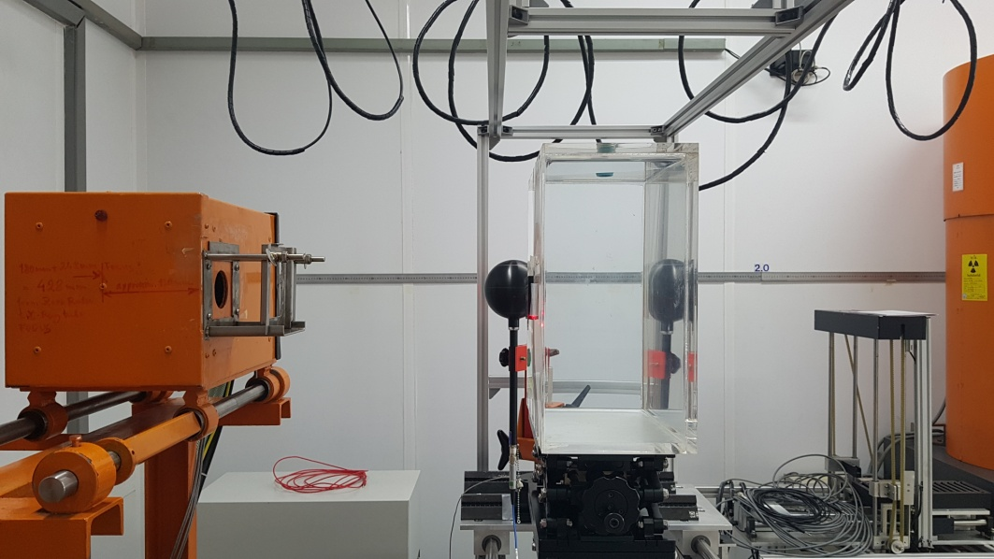
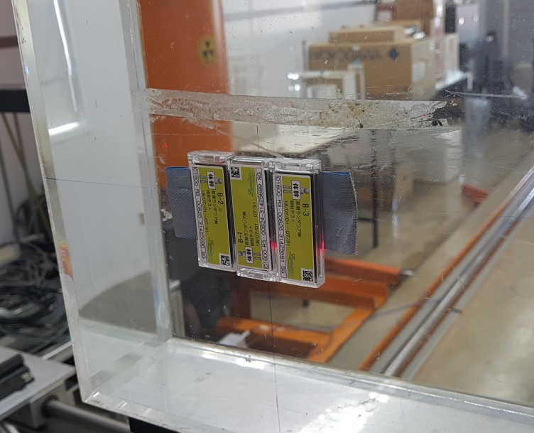
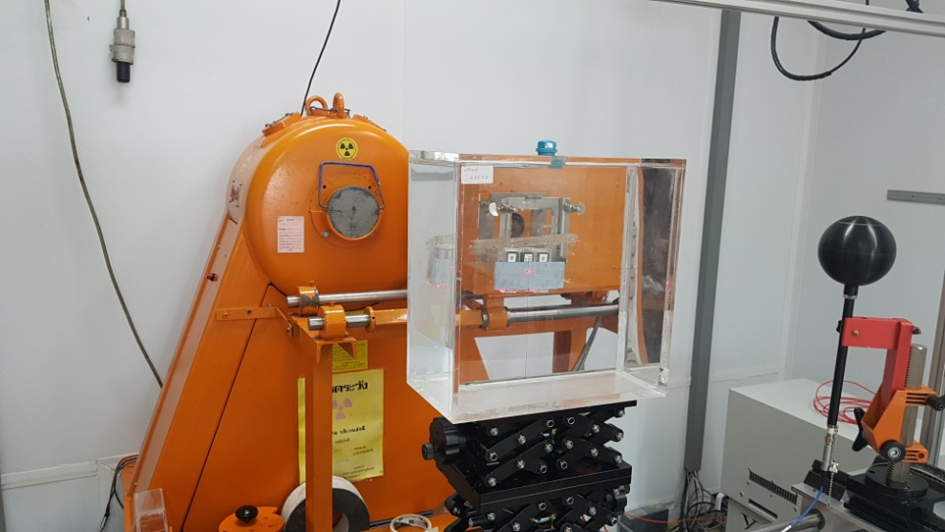
Irradiation to the Cs-137 Beam

Slide 9
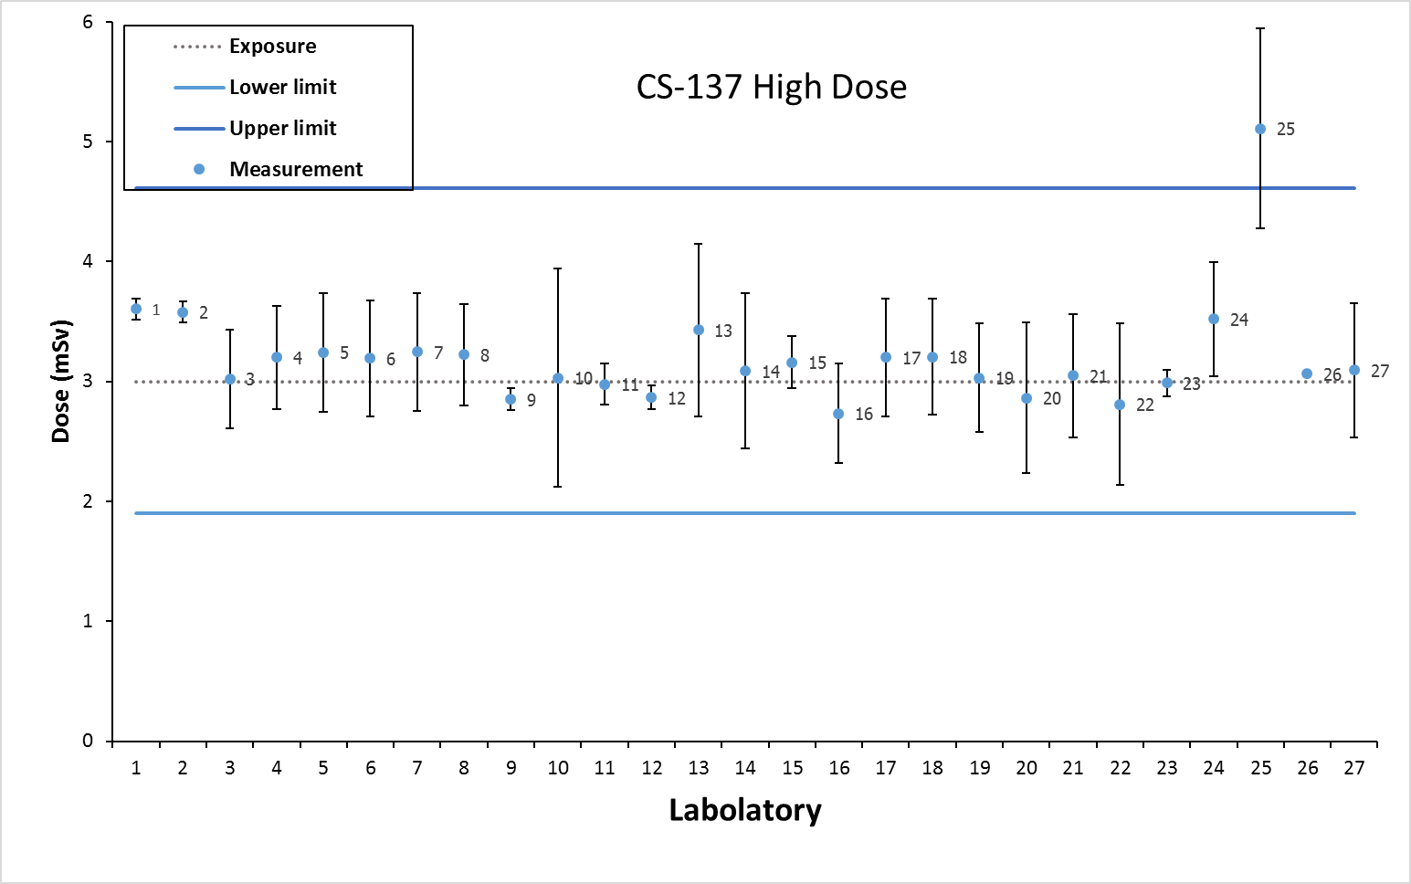
Measurement of Exposure to the Cs-137 High dose
Exposure: 3.00 mSv
Lower Limit: 1.90 mSv
Upper Limit: 4.61 mSv

Slide 10
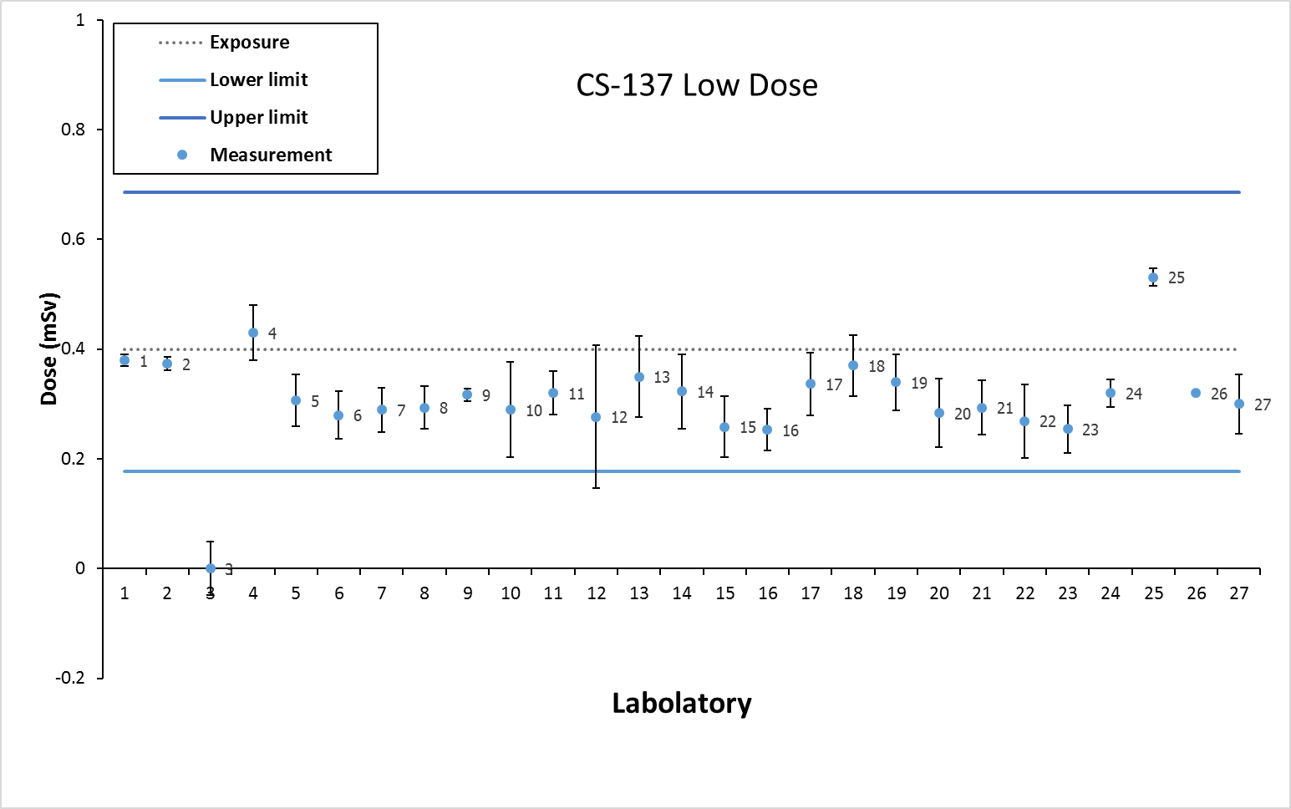
Measurement of Exposure to the Cs-137 Low dose
Exposure: 0.40 mSv
Lower Limit: 0.18 mSv
Upper Limit: 0.69 mSv

Slide 11
Irradiation to the X-ray Beam
Constant potential, tungsten target X-ray tube
Beam quality 120 kV, 10 mA
Water slab phantom 30 x 30 x 15 cm of water
Beam quality N-120 kV, 10 mA
2.00 mSv at high dose
0.40 mSv at Low dose
Beam quality N-80 kV, 10 mA
4.00 mSv at high dose
0.40 mSv at Low dose
Beam quality N-60 kV, 10 mA
2.00 mSv at high dose
0.40 mSv at Low dose
Traceability: IAEA
15 cm
Cs-137 source
30cm
Personal dosimeters
100cm

Slide 12
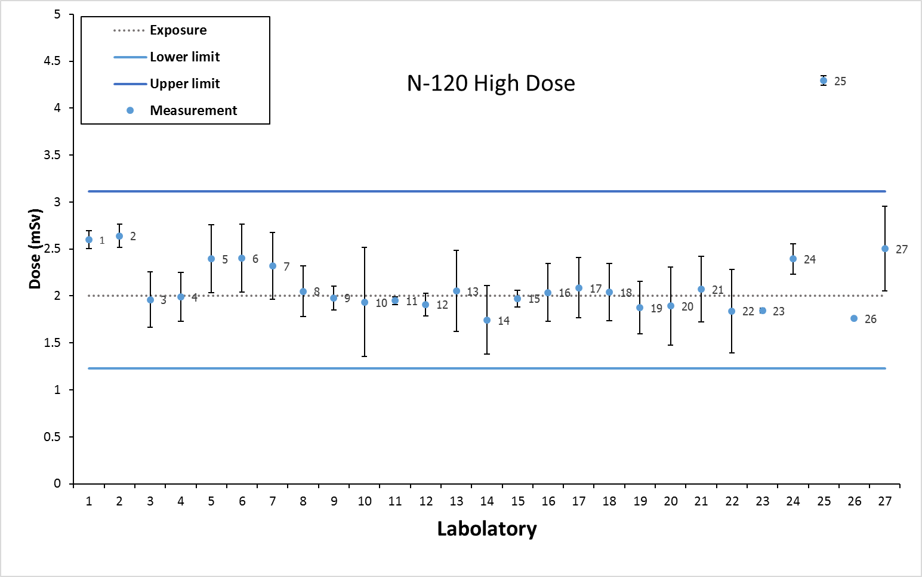
Measurement of Exposure to the X-ray beam N-120 at high dose
Exposure: 2.00 mSv
Lower Limit: 1.23 mSv
Upper Limit: 3.11 mSv

Slide 13
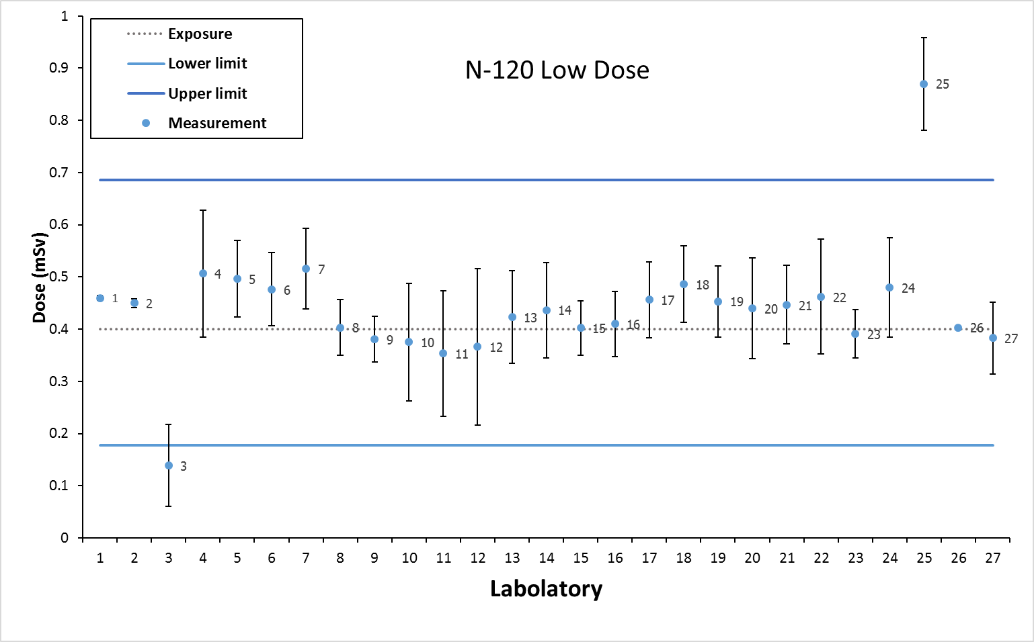
Measurement of Exposure to the X-ray beam N-120 at low dose
Exposure: 0.40 mSv
Lower Limit: 0.18 mSv
Upper Limit: 0.69 mSv

Slide 14
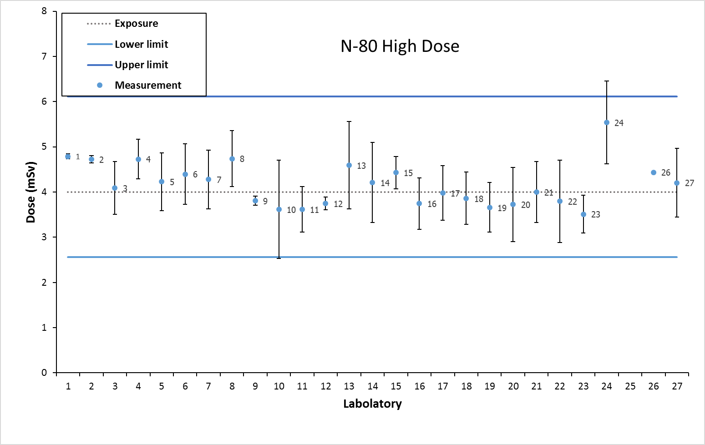
Measurement of Exposure to the X-ray beam N-80 at high dose
Exposure: 4.00 mSv
Lower Limit: 2.56 mSv
Upper Limit: 6.12 mSv

Slide 15
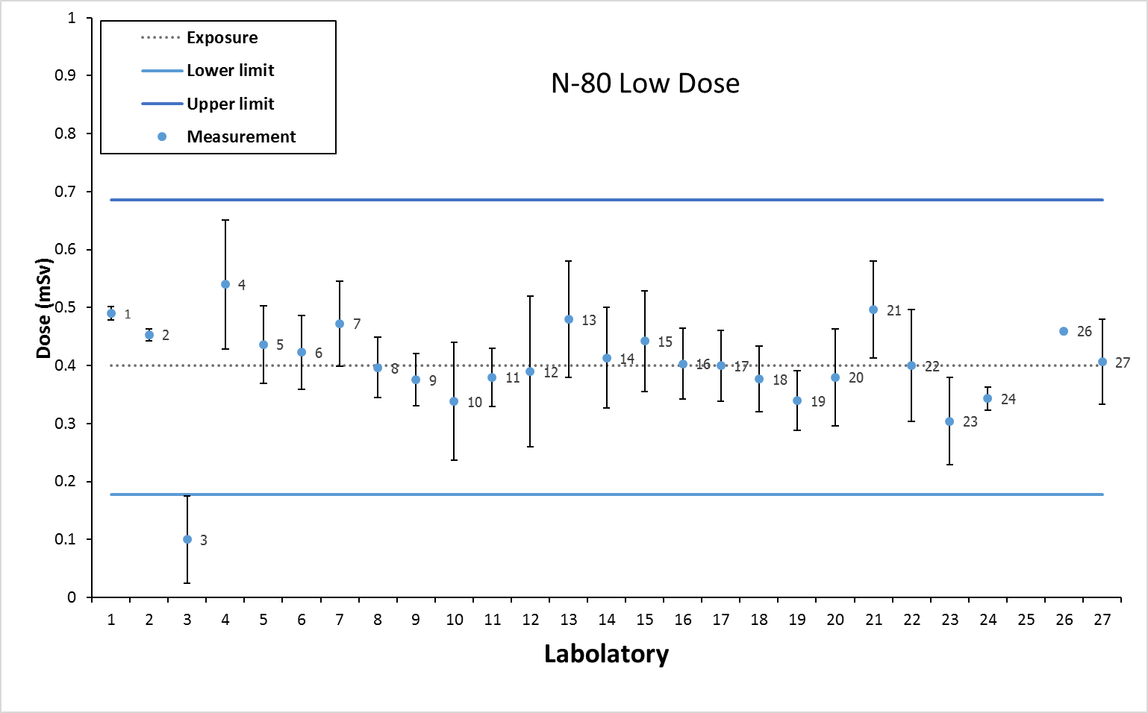
Measurement of Exposure to the X-ray beam N-80 at low dose
Exposure: 0.40 mSv
Lower Limit: 0.18 mSv
Upper Limit: 0.69 mSv

Slide 16
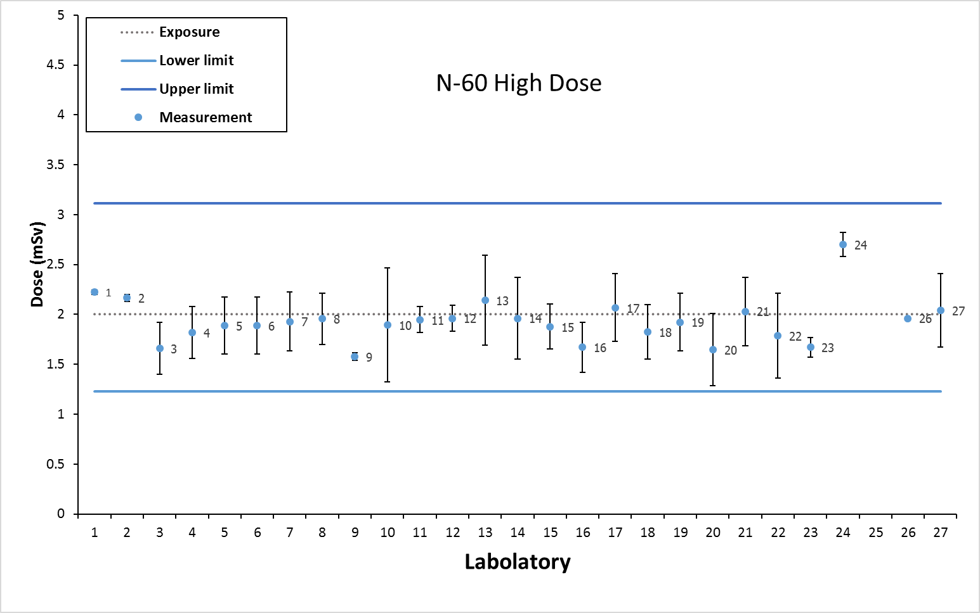
Measurement of Exposure to the X-ray beam N-60 at high dose
Exposure: 2.00 mSv
Lower Limit: 1.23 mSv
Upper Limit: 3.11 mSv

Slide 17
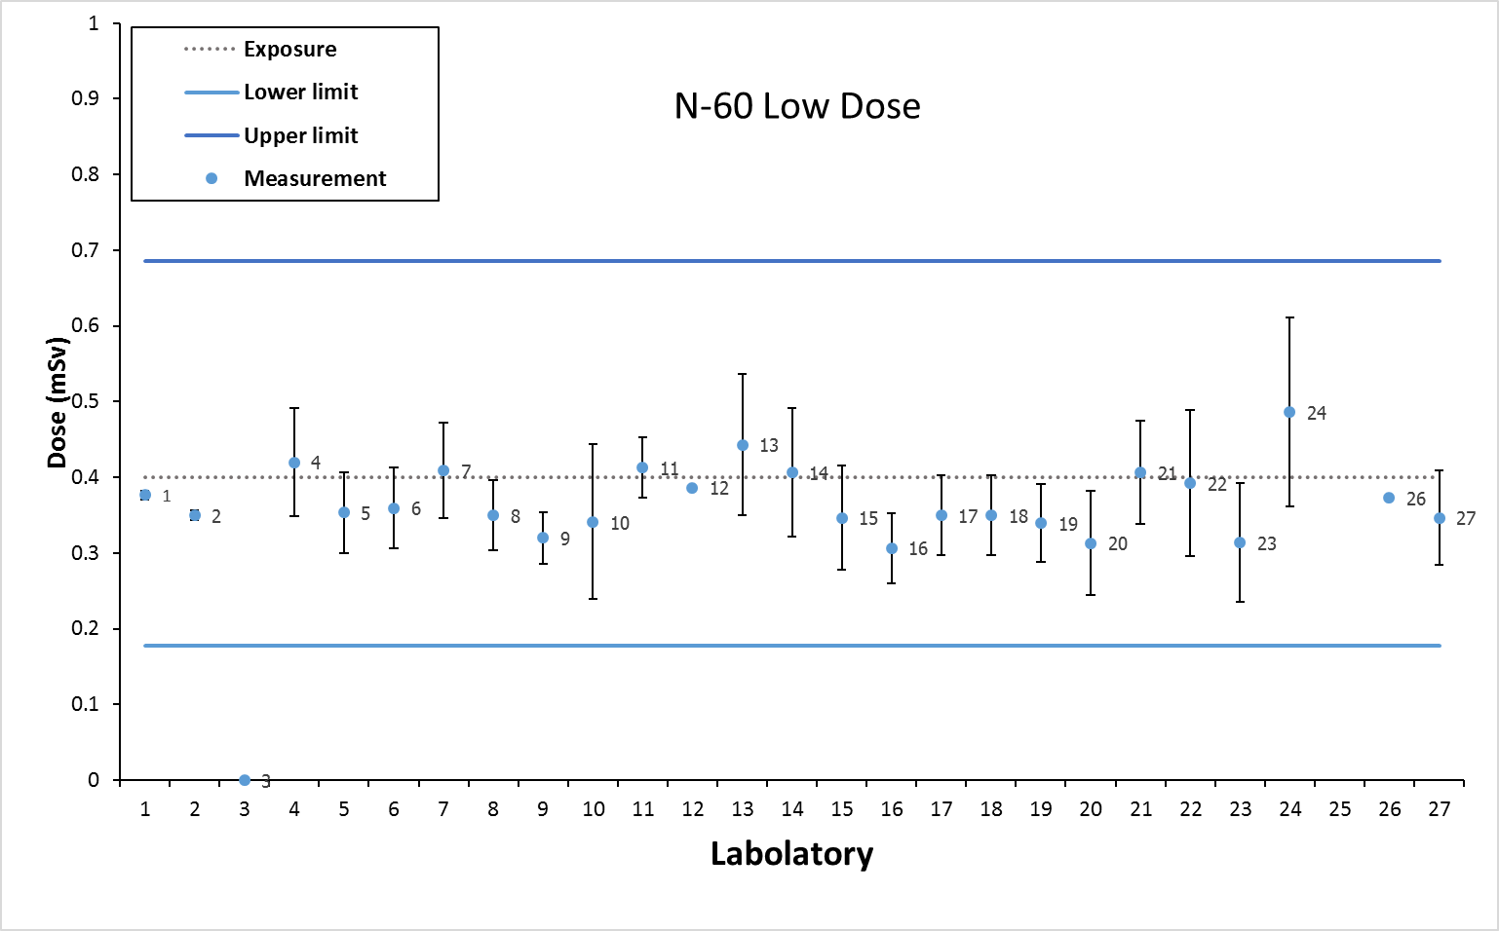
Measurement of Exposure to the X-ray beam N-60 at low dose
Exposure: 0.40 mSv
Lower Limit: 0.18 mSv
Upper Limit: 0.69 mSv

Slide 18
Thank you for your attention
Office of Atoms for Peace

