Slide 1
The development of H'(3) and Hp(3) standards for photons and beta-rays at NMIJ
Tadahiro Kurosawa, Masahiro Kato
NMIJ

Slide 2
Contents
Developments for H(3)
  H(3) for photons
  H(3) for beta-rays
Recent researches and topics
  Absorbed dose to water for ion beams
  High dose dosimetry
  Very low dose rate irradiation facility
  Re-evaluation of air-kerma for ICRU report 90
  Accreditation for personal dosimetry service in Japan

Slide 3
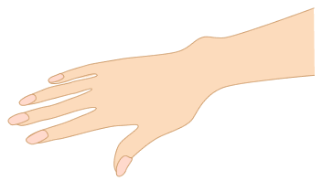
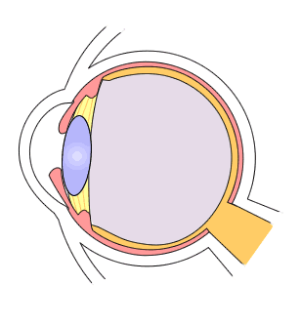

Introduction
・The dosimetry for H(3) is the current interest because of the ICRP recommendation in 2011.
・The IAEA also recommend the new dose limit as following ICRP in TECDOC1731 (2013).
・EU decided to adopt new dose limit for the lens of the eyes.
・Radiation Council in Japan also recommended the new dose limits.
Old
H(0.07)
New
H(3)
H(10)
*Note
*Note
*Note
*20 mSv in a year, averaged over 5 years, with no single year exceeding 50 mSv.

Slide 4
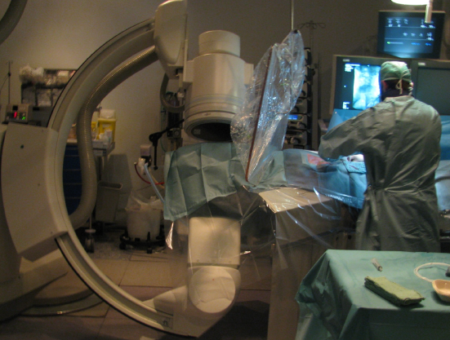
Interventional Radiology
The risk of cataract are increase for IVR operators.

Slide 5
H(3) for photos

Slide 6
Conversion coefficients, H(3)/K_{air}
Monoenergetic photons
● ICRU sphere
The Phantom dependence is 7% - 11% in the range of 50 keV-200 keV.
Probably scattered photons cause the dependence.
▲ Cylindrical phantom
■EGS5 code
■Incident photon energy: 10keV-10MeV
■Cut off energy：
electron10MeV、photon 1keV
→Kerma approximation
■Score the deposit energy at the point
where reactions occur.
■History number:10¹⁰ - 10¹³
■ ICRU slab

Slide 7
Angular dependence
15°
30°
45°
60°
75°
90°

Slide 8
IEC61267:2005 RQR fields
Energy spectra calculated with MCNP code
● RQR2
△ RQR3
□ RQR4
● RQR8
△ RQR9
□ RQR10
 | Tube voltage (kV) | Thickness of filter (mmAl)
 |  | This work | ORAMED [a] | UPC [b]
RQR10 | 150 | 4.62 | - | -
RQR9 | 120 | 3.84 | 3.39 | 3.5
RQR8 | 100 | 3.40 | - | 3
RQR7 | 90 | 3.22 | 3.0 | 3
RQR6 | 80 | 3.00 | - | 3
RQR5 | 70 | 2.88 | - | 2.5
RQR4 | 60 | 2.67 | 2.72 | 2.5
RQR3 | 50 | 2.48 | - | 2.5
RQR2 | 40 | 2.47 | - | 2.5
● RQR5
△ RQR6
□ RQR7
[a] F. Vanhavere et al, ORAMED: Optimization of Radiation Protection of Medical Staff, ERADOS report 2012-02 (2012)
[b] S. Principi et al, Radiation Protection Dosimetry 170, 45-48 (2016)

Slide 9
h(3,0°) for the RQR fields
 | Effective Energy (Eeff) |  |  |  |  | difference | Difference from estimated h(3)value based on the effective energy
RQR10 | 48.33 | 1.595 | 1.507 | 1.488 | - | - | 6%
RQR9 | 41.97 | 1.524 | 1.450 | 1.435 | 1.456 | 1.5% | 3%
RQR8 | 37.73 | 1.454 | 1.393 | 1.381 | 1.394 | 1% | <2%
RQR7 | 35.64 | 1.412 | 1.358 | 1.348 | 1.368 | 1.5% | <1%
RQR6 | 33.49 | 1.360 | 1.315 | 1.308 | 1.336 | 2% | <2%
RQR5 | 31.51 | 1.308 | 1.271 | 1.266 | 1.270 | 1% | <2%
RQR4 | 29.56 | 1.250 | 1.222 | 1.218 | 1.232 | 1% | <2%
RQR3 | 27.32 | 1.177 | 1.158 | 1.156 | 1.178 | 2% | <2%
RQR2 | 25.13 | 1.110 | 1.099 | 1.098 | 1.106 | 1% | <2%
This work
Principi et al

Slide 10
h(3,0°) for the N series specified in ISO4037-3
 | Effective Energy (Eeff) |  |  |  |  |  |  | Difference from estimated h(3)value based on the effective energy
N-300 | 253.36 |  | 1.403 | 1.317 | 1.338 | 1.32(0.2%) | 1.34(0.1%) | <1%
N-250 | 209.33 |  | 1.459 | 1.359 | 1.383 | 1.36(0.1%) | 1.38(0.2%) | <1%
N-200 | 165.13 |  | 1.532 | 1.415 | 1.441 | 1.42(0.4%) | 1.44(0.1%) | <1%
N-150 | 117.88 |  | 1.671 | 1.524 | 1.557 | 1.52(0.2%) | 1.54(1.1%) | <1%
N-120 | 100.63 |  | 1.743 | 1.581 | 1.618 | 1.58(0.1%) | 1.60(1.1%) | <1%
N-100 | 83.04 |  | 1.814 | 1.639 | 1.675 | 1.63(0.6%) | 1.66(0.9%) | <1%
N-80 | 64.15 |  | 1.831 | 1.665 | 1.696 | 1.66(0.3%) | 1.68(1.0%) | <1%
N-60 | 46.38 |  | 1.678 | 1.567 | 1.584 | 1.54(1.7%) | 1.54(2.8%) | <1%
N-40 | 31.75 |  | 1.317 | 1.285 | 1.287 | 1.28(0.4%) | 1.27(1.3%) | <3%
N-30 | 23.26 |  | 1.069 | 1.061 | 1.063 | 1.04(2.0%) | 1.03(3.2%) | <4%
This work
Behrens (difference)
R.Behrens, Radiation Protection Dosimetry, 151 450-455 (2012)

Slide 11
Summary
Air kerma to H(3) conversion coefficients for the AIST/NMIJ X-ray standard field were obtained and test and calibration became possible.
For ISO N series fields, the conversion coefficients may differ by 2% or more depending on the x-ray when the tube voltage is 60 kV or less.
In the RQR beam quality, the conversion coefficients in AIST/NMIJ fields were compared those in the fields which have same RQR index but different filter thickness. The conversion factors agreed within 2%.
Estimation of conversion factor from the effective energy is possible with 2% difference in many cases, but note that large difference may appear such as in RQR10.
New ISO 4037 series “X and gamma reference radiation for calibrating dosemeters and doserate meters and for determining their response as a function of photon energy” is released in this year, and conversion coefficients for H’(3) and Hp(3) are listed in it.

Slide 12
H(3) for beta-rays

Slide 13
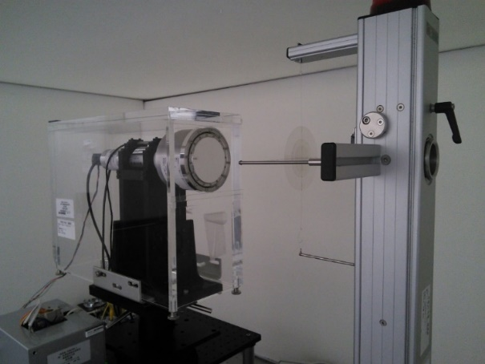
Measurements of D(0.07)・D (3) using the extrapolation chamber
70 μm
3 mm
Estimation of absorbed
dose to tissue
W₀/e | W value
S_{t,a} | The ration of stopping power
ρ_{a0} | Air density
a | Area of collecting electrode
κ | Correction factors
k | Correction factors
曲線は y = ax² + bx + c によるフィット結果
 | 70 μm | 3 mm
a | (2.3 ± 3.2)×10⁻¹⁶ | (-1.16 ± 0.34)×10⁻¹⁶
b | (2.5687 ± 0.0097)×10⁻¹³ | (1.1065 ± 0.0105)×10⁻¹³
c | (6.22± 6.6)×10⁻¹⁵ | (1.883± 0.071)×10⁻¹⁴

Slide 14
Necessity of conversion factors for beta-rays
The measurement condition using an extrapolation chamber is for the absorbed dose of slab phantom.
Need the conversion factors from Hp(3, 0 degree:ICRU slab) to H’(3, a:ICRU sphere) and Hp(3,a:ICRU cylinder)
These conversion factors are estimated by EGS5.

Slide 15
Difference of phantoms(Slab, Sphere, Cylinder)
● ICRU sphere
EGS5(This work)
●Cylinder
●Sphere
h (Sv/ｃｍ-２)
□ ICRU slab
There are no large differences for absorbed dose to tissue at 0 degree for different phantoms.

Slide 16
Angular dependence for h’(0.07) and h’(3)
EGS5(This work)
●h’(0.07)
■h’(3)
EGSnrc
(Rehrens (2015)
JINST 10 P03014)
〇h’(0.07)
□ h’(3)

Slide 17
Summary
Developing for H’(3) and Hp(3) for beta-rays
Need conversion factors from H’(0.07) to H(3)
Developing medium energy fields for H(3). (Sr-90/Y-90 source with thick filters)
Revision of ISO 6980 “Reference beta-particle radiation” will be started in next year.

Slide 18
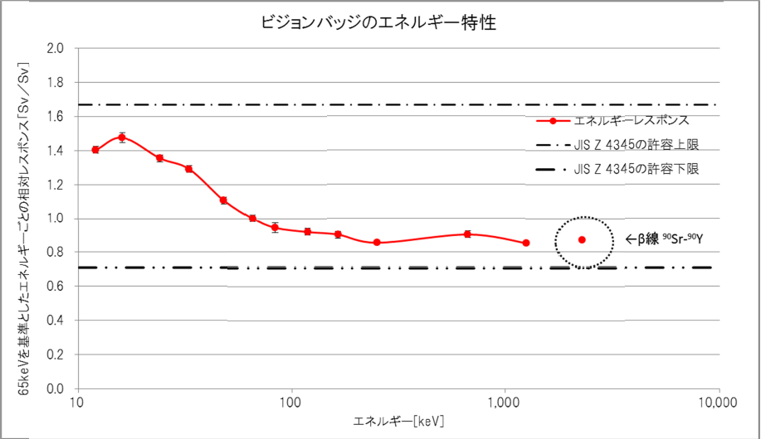
Vision badge
(Nagase Landauer LTD.)

Slide 19
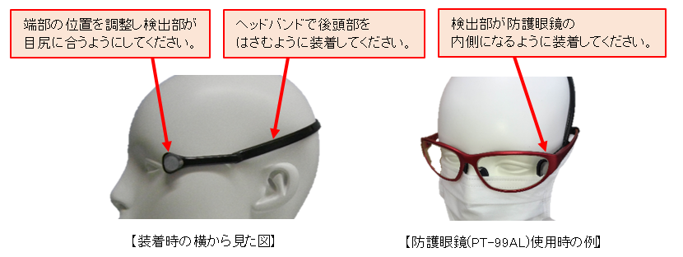
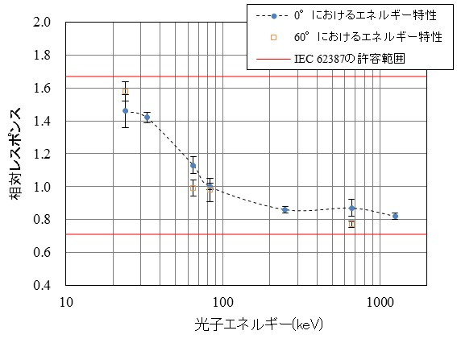
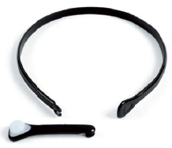
DOSIRIS (developed by IRSN)
(Chiyoda Technol Co.)

Slide 20
Clinical proton and ion beams

Slide 21
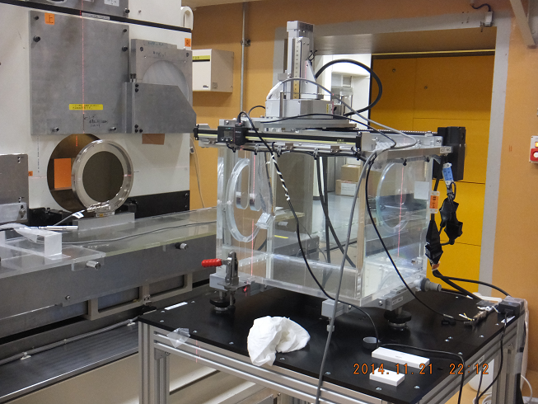
Absorbed dose to water for clinical carbon beams
Heavy Ion Medical Accelerator in Chiba (HIMAC) at the National Institute of Radiological Sciences (NIRS, Chiba, Japan) for carbon beams.
Tsukuba University for proton beams.
・The compact graphite calorimeter and the water calorimeter are developed for the portable device.(but these are not easy to carry by hand!)
・The compact graphite calorimeter is more easy to use.
water phantom
Monitor chamber
(PTW34014)
graphite ionization chamber
(parallel plate type)

Slide 22
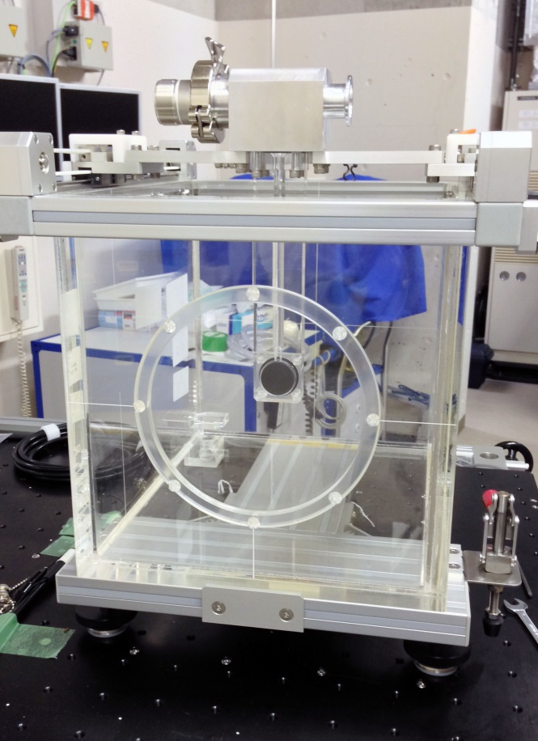
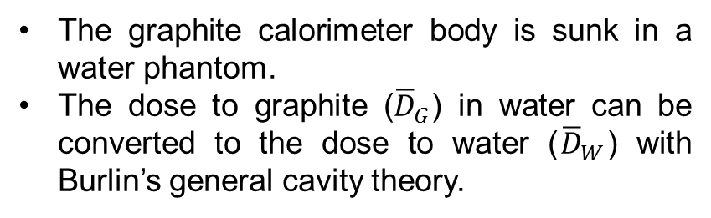
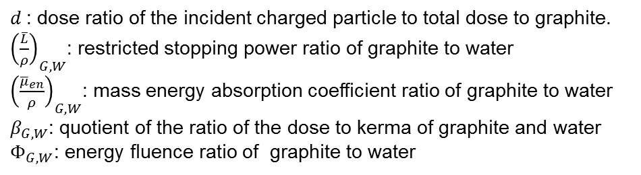
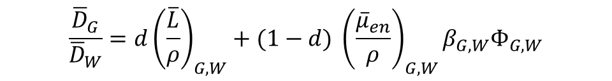
Compact graphite calorimeter
We are developing a compact graphite calorimeter as a field standard for high-energy photon beams at a secondary standard dosimetry laboratory.
PMMA sleeve
The graphite calorimeter body is sunk in a water phantom.
The dose to graphite (${\overline{D}}_{G}$) in water can be converted to the dose to water (${\overline{D}}_{W}$) with Burlin’s general cavity theory.
$$\frac{{\overline{D}}_{G}}{{\overline{D}}_{W}}={d\left(\frac{\overline{L}}{ρ}\right)}_{G,W}^{}+(1−d) {\left(\frac{{\overline{μ}}_{en}}{ρ}\right)}_{G,W}β_{G,W}Φ_{G,W}$$
$d$: dose ratio of the incident charged particle to total dose to graphite.
${\left(\frac{\overline{L}}{ρ}\right)}_{G,W}^{}$: restricted stopping power ratio of graphite to water
${\left(\frac{{\overline{μ}}_{en}}{ρ}\right)}_{G,W}$: mass energy absorption coefficient ratio of graphite to water
$β_{G,W}$: quotient of the ratio of the dose to kerma of graphite and water
$Φ_{G,W}$: energy fluence ratio of graphite to water
Graphite Calorimeter
Compact graphite calorimeter in a water phantom

Slide 23
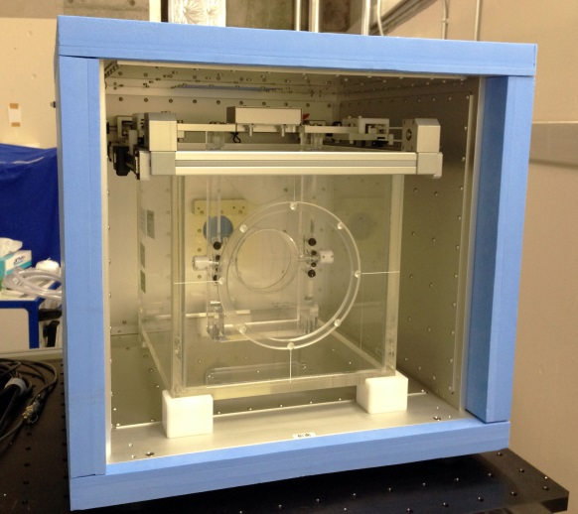
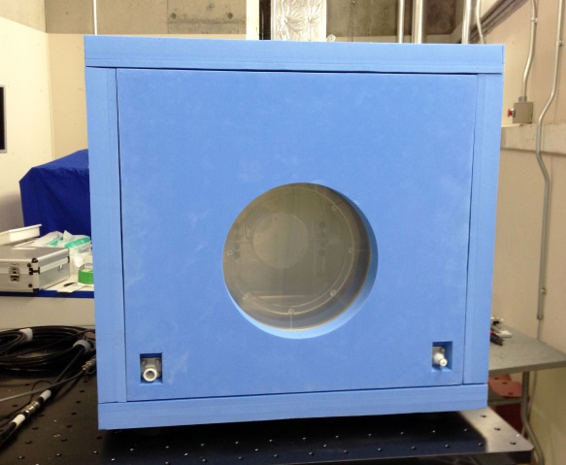
Water calorimeter
A water calorimeter is developed as a primary standard of the dose to water for a clinical charged particle beam.
The temperature stability of water is ~0.01 K.
The water temperature in glass cell is measured by using AC lock-in amplifier bridge.
Glass cell and water phantom
To verify the conversion of dose to graphite to dose to water, we will measure the absorbed dose to water for the high-energy photon and electron beams by using the water calorimeter and the compact calorimeter.
Thermostatic chamber

Slide 24
High Dose Dosimetry

Slide 25
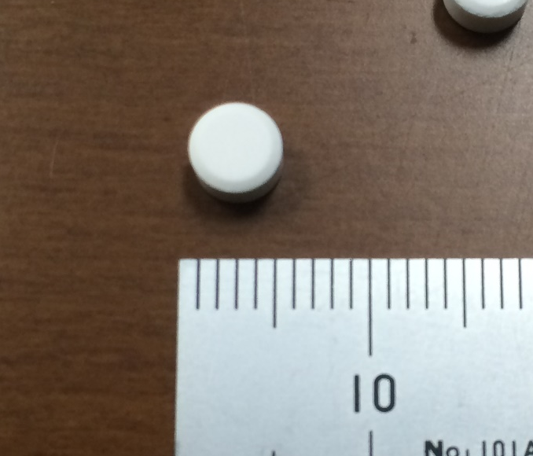
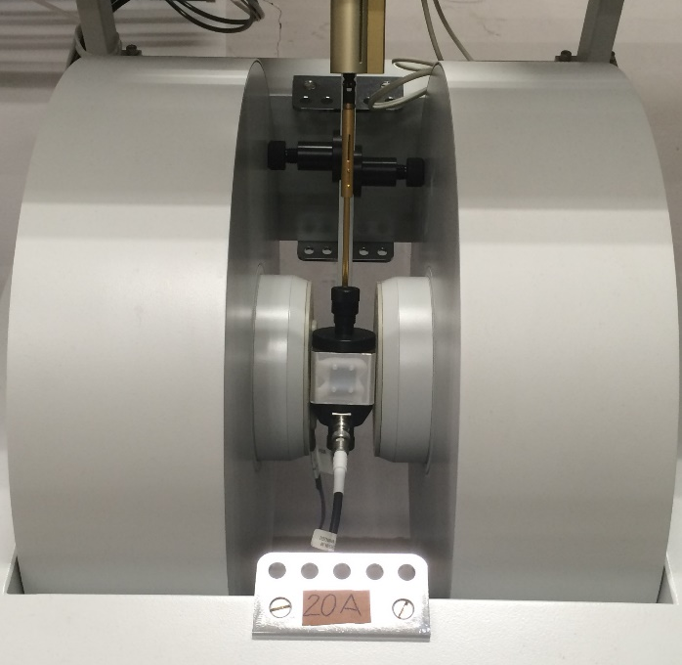
Alanine/ESR dosimetry for high dose measurement
Alanine Pellet (Made by Harwell Dosimeter Ltd)
ESR spectrometer
Diameter: 4.8 mm
Height: 2.7 mm
Electromagnet
Cavity
Required characterization and evaluation
Irradiation temperature
Irradiation humidity
Dose
Dose rate
Fading
ESR measurement temperature

Slide 26
Low dose rate irradiation system

Slide 27
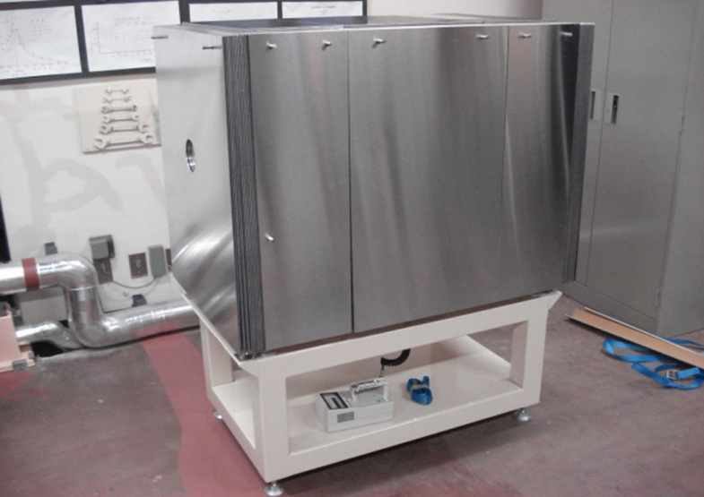
Low dose rate irradiation system
It becomes important to measure around 0.2 μSv/h because of decontamination level after the nuclear accident.
Current irradiation facility calibrates above 3 μSv/h for Cs-137.
30 mm lead wall for shielding.
B.G. is below 0.01μSv/h
New irradiation system is developing for low dose rate (0.1~3.0 μSv/h).

Slide 28
Scattering radiation in the irradiation system
The photon energy spectra of Cs-137 in this irradiation system were measured with a CdZnTe detector and the contribution of scattered photons is evaluated.
The measured data were unfolded to obtain photon energy spectra.
The dose rate of scattered photons is less than 10 % of that of the direct gamma-rays from Cs-137.
Dose rate (Sv/h)
Photon energy (MeV)

Slide 29
Uncertainty budget
 | Relative uncertainty (%)
Calibration coefficient for 15000cm³ chamber | 1.1
Current measurement | 1.2
Temperature | 0.1
Pressure | 0.1
Humidity | 0.02
Position of chamber | 0.18
Position of source | 0.18
Non-uniformity | 1.01
Conversion coefficient for H*(10) | 0.63
Combined standard uncertainty for air-kerma | 1.92
Combined standard uncertainty for H*(10) | 2.02

Slide 30
Re-evaluation of air-kerma for ICRU report 90

Slide 31
ICRU Report 90
Key Data For Ionizing-Radiation Dosimetry: Measurement Standards And Applications
Stopping power for charged particle
Mean excitation energies for air, graphite, water
Photon cross sections for air, graphite, water
Heat defect for graphite, water
W_air (uncertainty is increased)
the correction to the measured charge due to the initial ion pairs created by an incident photon
the deviation of W_air at low energies
Increase in the uncertainty for air-kerma measurements with free-air chambers.
Decrease of about 0.7 % in ⁶⁰Co air-kerma measurements.
Decrease of about 0~1 % in air-kerma measurements at low energy X-rays.

Slide 32
Recommendation at CCRI(I)
W value of air
  No change for the value (33.97 J/C)
  Uncertainty is changed from 0.15 % to 0.35 % except Co-60.
I value and stopping power
  Graphite : 78 eV ⇒81 eV
  Water: 75 eV⇒78 eV
  Air: no change 85.7 eV, but for C beam, 82.8 eV

Slide 33
Air kerma using a cavity chamber
  Adopt Wair・sg,air=33.72 for Co-60
  Change the sg,air value for Cs-137 and Ir-192, and re-evaluate uncertainties
Air kerma using a free-air chamber
  New correction factor kii and kw

Slide 34
Change of air-kerma at NMIJ
NMIJ will change the air-kerma for gamma-rays and X-rays at 1st of April 2019.
Air-kerma for gamma-rays
Nuclide | k_{s-ICRU90} | Uncertainty (k = 2)
Co-60 | 0.9916 | 1.0 %
Cs-137 | 0.9919 | 0.8 %➡0.9 %
Ir-192 | 0.9917 | 1.2 %➡1.4 %

Slide 35
Air-kerma for X-rays
  kw: correction for the energy dependence of W value
  kii: correction for the charge of initial electron produced by X-ray
  Increase of Uncertainty ( around +0.2 %)
  Decrease of air-kerma rate because of new correction factors

Slide 36
Accreditation for personal dosimetry service in Japan

Slide 37
Japan Accreditation Board(JAB) started the accreditation program for the personal dosimetry service in last year.
NIST handbook 150-4 was referred to developed our program.
  National Voluntary Laboratory Accreditation Program(NVLAP), “Ionizing Radiation Dosimetry”

Slide 38
Proficiency test
Proficiency test is referred the following,
  ANSI N13.11 “Personnel Dosimetry Performance – Criteria for Testing”
  ANSI N13.32 “Performance Testing of Extremity Dosimeters”
In NVLAP program, no performance requirements for dosimeters⇒Just pass the proficiency test!
In JAB program, require to match the JIS (Japan Industrial Standards) for dosimeters⇒To reduce the proficiency test points!

Slide 39
Thank you for your attention!
ขอบคุณค่ะ

