Slide 1
Dosimetry Standards at NMIJ/AIST
Ionizing Radiation Standards Group
Researcher: T. Kurosawa, M. Kato, Y. Morishita,
T. Tanaka, M. Shimizu, H.Yamaguti
J. Ishii
Technical staff for calibration service
: R. Noda, N. Matsuura
Notes:
I talk about radiation dosimetry standards at NMIJ.
Our group have 5 sources, gamma ray from Cobalt and Cs, medium and low energy X-ray, beta-particle source, synchrotron radiation.

Slide 2
Organization
AIST(National Institute of Advanced Industrial Science and Technology)
NMIJ
(National Metrology Institute of Japan)
Ionizing Radiation Standards Group
Research Institute for
Engineering Measurement
Group leader Tadahiro Kurosawa
7 researchers
2 technical staffs
Research Institute for
Physical Measurement
Research Institute for
Material and Chemical Measurement
Radioactivity and Neutron Standards Group
Research Institute for
Measurement and Analytical Instrumentation
Group leader Akira Yunoki
6 researchers
1 technical staff

Slide 3
Dosimetry standards
Protection
  Air kerma for Cs-137, Co-60 (T.Kurosawa)
  Air kerma for low dose rate of Cs-137 (0.1~3 μSv/h) (T.Kurosawa)
  Air kerma for medium energy X-rays, 30 kV - 300 kV (T.Tanaka)
  Air kerma for low energy X-rays, 10 kV-50 kV (T.Tanaka)
  Dose equivalent of X-ray & γ-ray (T.Kurosawa, T.Tanaka)
  Absorbed dose to tissue, β-rays (Sr-90/Y-90, Kr-85, Pm-147) (M.Kato)
Developing
  Dose equivalent in 3 mm depth (Kato & Kurosawa)
  Air kerma in high energy photons using a linac (T.Kurosawa)
  Diagnostics (T.Tanaka)
  Mammography (Mo/Mo, Mo/Rh, Rh/Rh, W/Rh, W/Ag, W/Al)

Slide 4
Dosimetry standards
Therapy
  Co-60 (absorbed dose to water) (Y.Morishita)
  β-ray brachytherapy Ru-106 (M.Kato)
  High-energy photons (M.Shimizu)
  HDR brachytherapy Ir-192 (T.Kurosawa)
  Developing
  High-energy electrons (T.Tanaka)
  Proton and Carbon beams (T.Tanaka & M.Shimizu)
  Water calorimeter (M.Shimizu)
  High dose
  Developing
  Alanine dosimetry (H. Yamaguti)

Slide 5
Facilities
X-rays
  Low energy X-rays (10 to 50 kV)
    W, Mo, Rh target
    Small free-air chamber
  Medium energy X-rays (50 to 300 kV)
    W target
    Large free-air chamber
Gamma-rays
  High dose rate room
    148 TBq Co-60, 34 TBq Cs
  Medium and low dose rate room
    185, 18.5, 3.7GBq Co-60, 222, 18.5, 1.85 GBq Cs-137
  Very low irradiation facility
    10 MBq Cs-137

Slide 6
  Cylindrical Graphite cavity chambers
    Two 60 cc chambers, and two 6 cc chambers
Clinical beam
  Clinical Linac (Electa)
    Graphite and Water calorimeter
Beta-rays
  Beta Secondary Standard 2(BSS2)
    Pm-147, Kr-85, Sr-90/Y-90, Ru-106/Rh-106
    Extrapolation chamber
The temperature and humid are controlled.
22±1 ℃ 50 %±20 %(humidity)

Slide 7
Equipments for standards
Electrometers for free-air, cavity and extrapolation chambers
  Vibrating-reed electrometer
  Capacitors (10nF, 1000pF, 500pF, 100pF)
Wheatstone bridge circuit for calorimeters
Thermometers, barometers and hydrometers

Slide 8
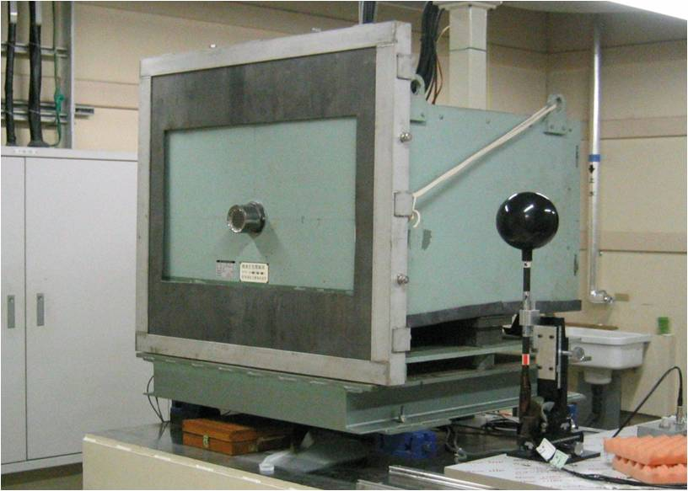
Medium energy x-rays
Free air chamber
(primary standard)
Calibration Item

Slide 9
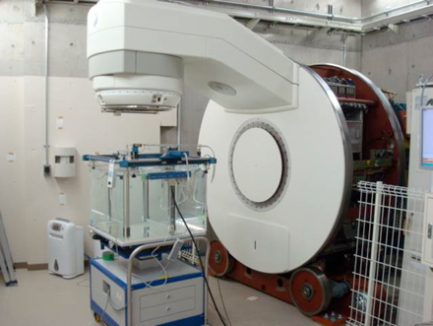
High energy photons from Linac

Slide 10
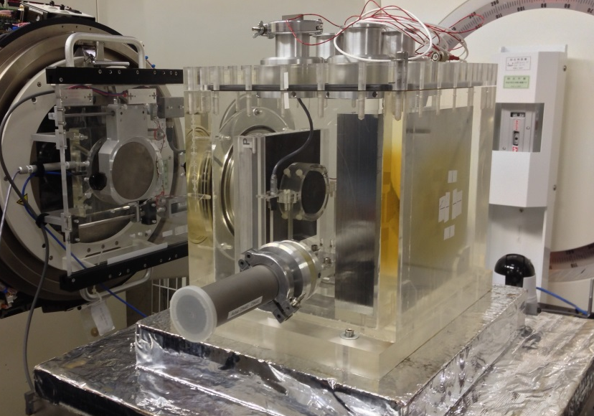
Key comparison BIPM.RI(I)-K6
BIPM graphite calorimeter
Comparison results
Energy | TPR_{20,10} | R (NMIJ/BIPM)
6 MV | 0.679 | 0.9966(47)
10, 15 MV | 0.729 | 0.9959(55)
NRC
PTB
NIST
NPL
NMIJ
ARPANSA
LNE-LNHB

Slide 11
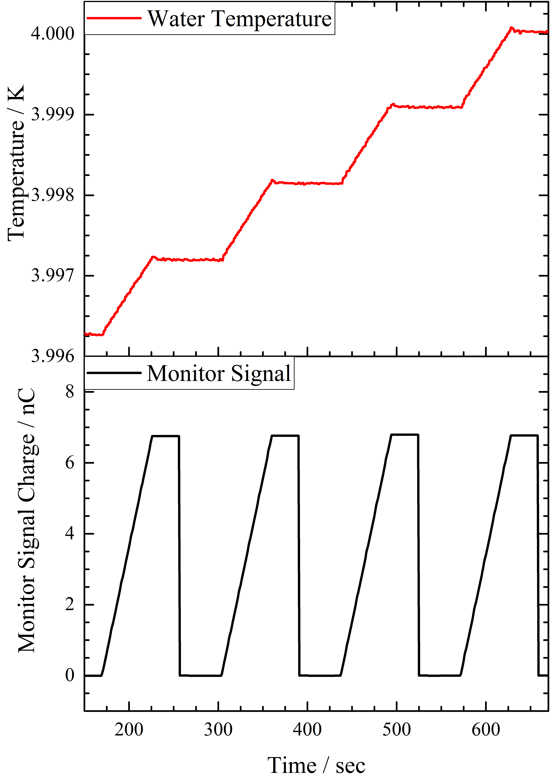
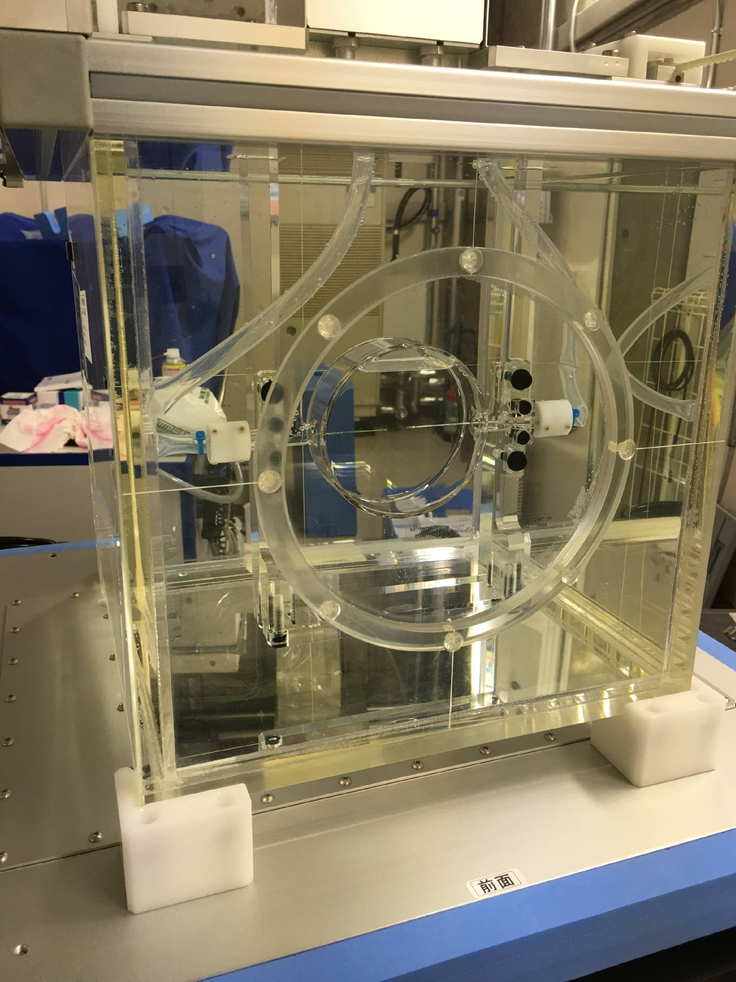
Water calorimeter
Glass cell

Slide 12
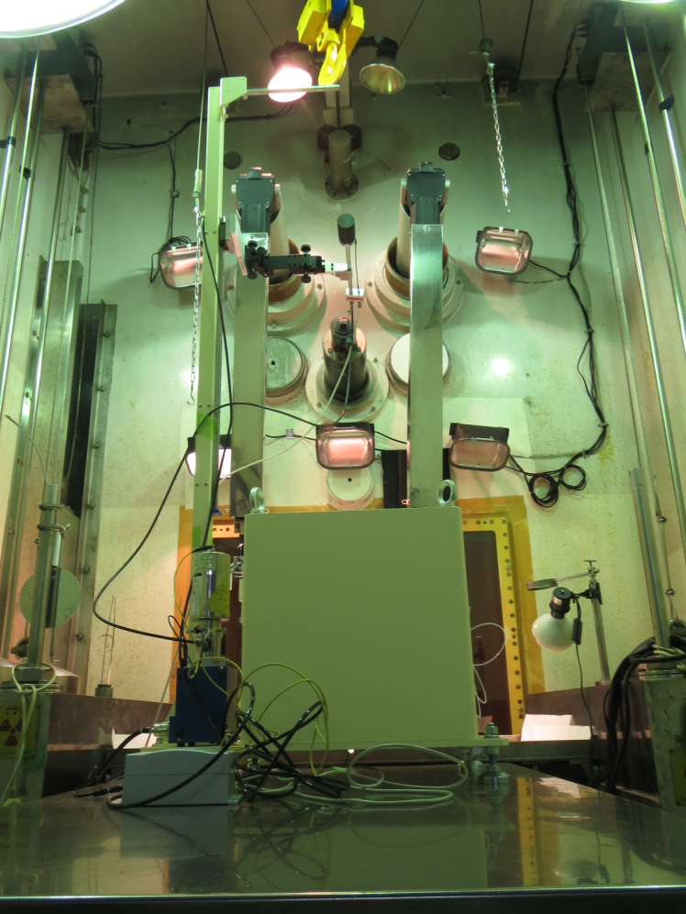
Reference air-kerma rate for Ir-192 HDR
ceiling
Cavity
chamber
1 m
Source
position
Floor

Slide 13
QA / QC
For QC
  Periodical check
    Gamma-rays and beta-rays
      Periodical dose rate measurements using primary chambers
      Compare the previous dose rate -> less than 0.1 %
  X-rays
    Calibrations of our woking standards(cavity chambers)
    Compare a calibration factor -> less than 0.2 %
These check include not only the check of primary standards but also other devices( electrometers, thermometers, barometers,,,,)

Slide 14
For QA
  Join the international comparison
    BIPM.RI(I)-K6, high energy photons (2015 April)
    BIPM.RI(I)-K8, Ir-192 brachytherapy (2015 April)
    BIPM.RI(I)-K3, medium energy X-rays (2015 Sep.)
    APMP.RI(I)-K3.2013, medium energy X-rays (2016)
    APMP.RI(I)-K8, Ir-192 brachytherapy (2017)、pilot
    High energy photons (KRISS, 2016 July)
    Personal dose equivalent (ARPANSA, 2016 Aug.)
  Review by the accreditation organization and foreign experts

Slide 15
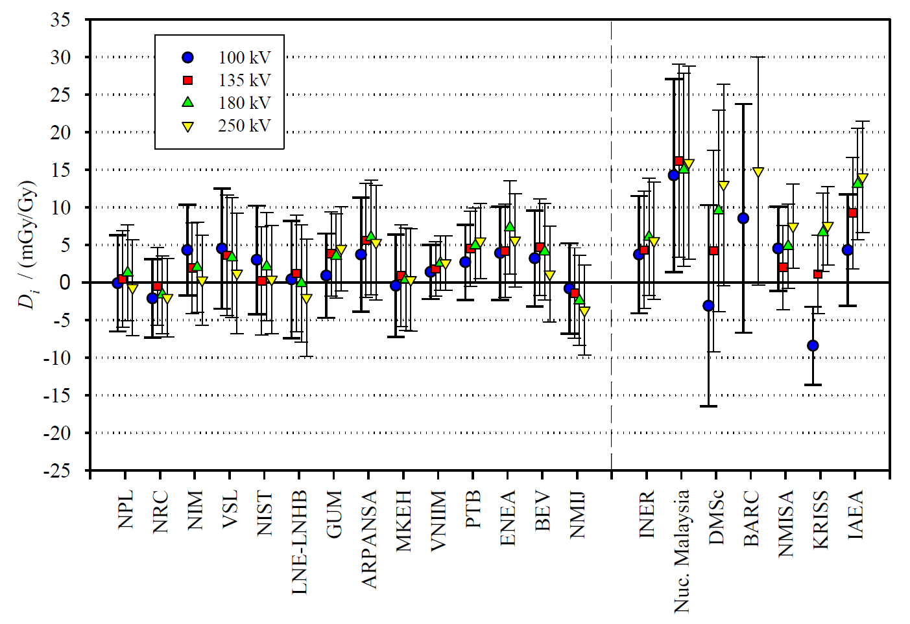
Key Comparison (BIPM.RI(I).K3)
Metrologia 53, 06002 (2016)
Key Comparison (BIPM.RI(I)-K3) in Sep. 2015.
Key Comparison (APMP.RI(I)-K3. 2013) in Feb. 2016

Slide 16
Number of calibration service
 | Chambers
Air kerma for gamma-rays | 17
Absorbed dose to water for Co-60 | 6
Medium energy X-rays | 8
Low energy X-rays | 4
Beta-rays | 1
High energy X-rays | 0
・NMIJ mainly calibrate secondary standards.
・There are 7 secondary laboratories for dosimeters calibration.
・We also do some irradiation service for the test of dosimeters and detectors. (samples is more than 500?)

Slide 17
Thank you for your attention!

