Slide 1
Workshop on Building Asia-Pacific individual Monitoring Service ( IMS) Capabilities towards Regional Sustainable Network
Bangkok, Thailand
18-20 March, 2019
Myanmar

Slide 2
Outline
Structure of organization
Purpose
Personal
Facilities and environmental conditions
Occupational and Medical Exposures Control Laboratory and its services
Participation in OSL data intercomparison program
Number of service/ samples
Problems/Needs
Conclusion

Slide 3
Structure of organization

Slide 4
Purpose
The purpose of personnel radiation monitoring section is to ensure that the workers who exposed directly or indirectly to ionizing radiation are kept within the dose limits recommended by the International Commission on Radiological Protection (ICRP) and to ensure that nobody is exposed to maximum permissible dose.

Slide 5
Personal
No. of Personal: 5 Persons
1. Director : Dr. Than Sint Naing
2. Supervisor : Dr. Sandar Aung
3. Principal Scientist : Ms.Kyi Kyi Myint
4. Radiation physicist : Ms. Hla Hla Win
5. Radiation physicist : Ms. Hla Hla Htay
Responsibility
Director (Dr. Than Sint Naing )
Authorized for All operational procedure
Supervisor (Dr. Sandar Aung)
General Management
OSLD Operation
Interlaboratory comparison
Principal Scientist and Radiation physicist (Ms. Kyi Kyi Myint)
_ Dose Reporting and Record Keeping
_ Assists all operation and custodian

Slide 6
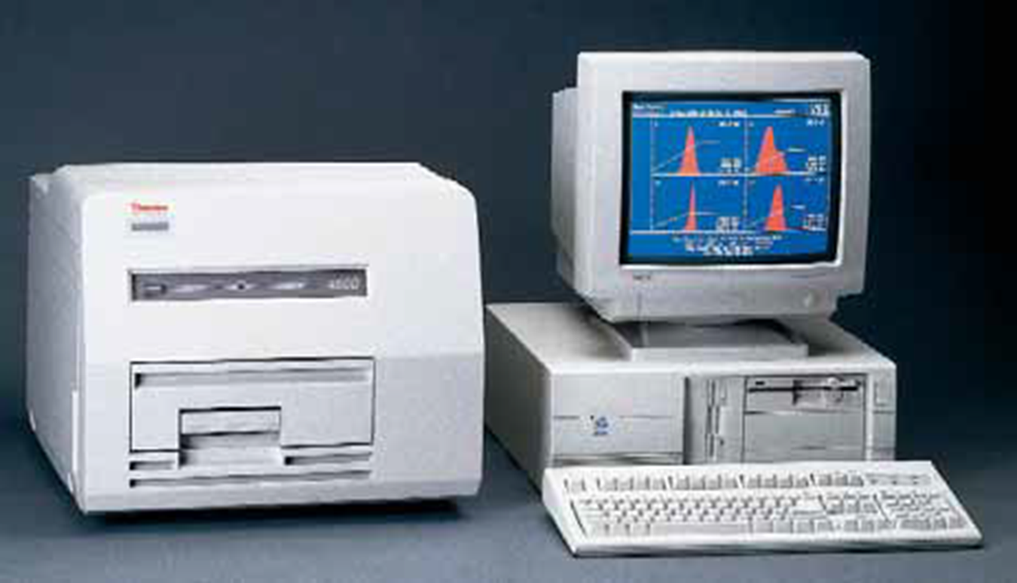
Facilities and environmental conditions
Harshaw 4500 ( Not used)
- 386 SX 3 20 processor or better. - Math Coprocessor - 200 megabyte hard disk drive - 2 MB RAM - One diskette drive - Dot matrix printer IBM pro printer compatible - Optional laser printer HP laser Jet II compact

Slide 7
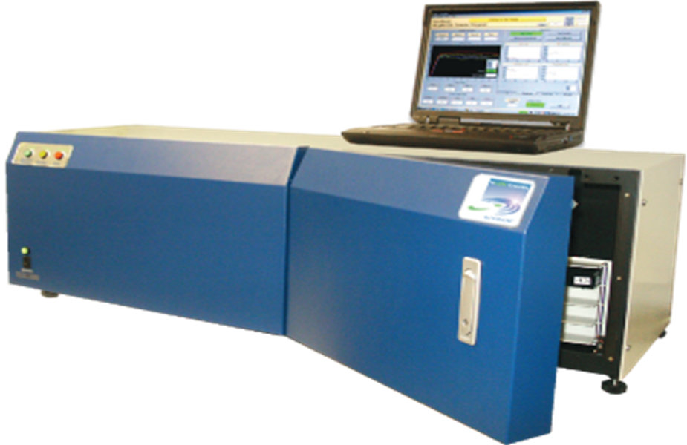
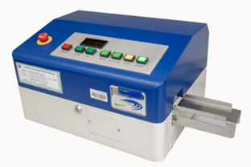
InLight® Auto 200 Reader System
The Auto 200 reader is ideal for personnel, area/environmental and emergency response monitoring. It reads radiation dose captured in aluminum oxide (Al₂O₃:C) detectors and measures the dose by using optically stimulated luminescence (OSL) technology pioneered by LANDAUER.

Slide 8
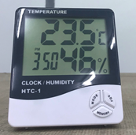
Technical Specifications
Operation Al₂ O₃ : C with OSL; high-sensitivity photon counting system and dose calculation algorithm
Speed Readout : in 12–13 sec
Capacity :4 magazines, 50 dosimeters each, 200 dosimeters per load
Energy dependence: Within ±10% over diagnostic energy range; within ±1% for photons and electrons from 5 MeV–20 MeV (please confirm)
LED array : 36
Size : 24.5”H x 17.5”W x15”D (40” x 27”x 26” with crate)
Power requirements :120–240V
Weight :100 lb. (150 lb. with crate)
Bar code input :Internal optical reader
Environmental Conditions
OSLD room: 22-25 $℃$, 20%-80% RH

Slide 9
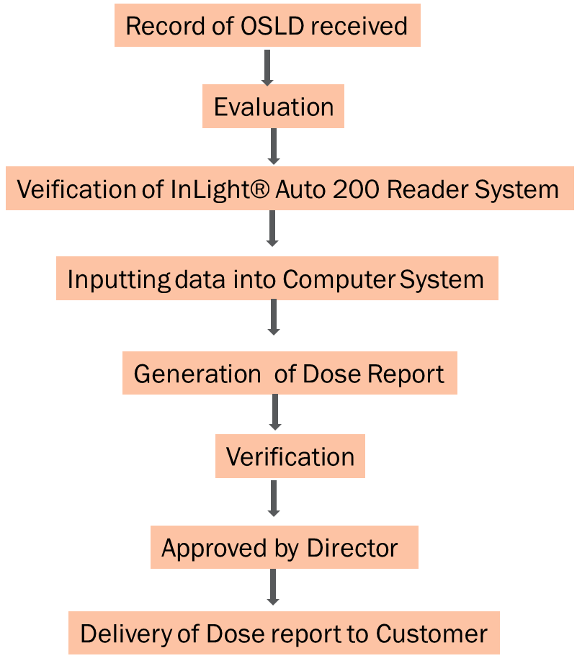
Supply of OSLD
Receipt of Customer
Request Letter
Identify
Government/Company
User Code
Preparation of OSLD
Packaging
Delivery to Customer
Workers wear
the OSL Dosimeter
While working
with Radiation

Slide 10
Occupational and Medical Exposures Control Laboratory
Personal Radiation monitoring service has been started since 1991 in Myanmar.
Harshaw 4500 TLD reader can’t use now and Government provided OSL System to DAE in the end of 2014.
TLD service has been replaced by OSL service throughout Myanmar since 2014.

Slide 11
OSLD Service
Monitoring |  | X-ray, Gamma, Beta radiation with OSL Technology
Monitoring Period (for one service) |  | 2 months
Application |  | Personal area/ environmental emergency response monitoring clinical dose measurement any radiation assessment
Services |  | Ks 8000 (U$$ 8) for private sector (hiring cost for 1 badge) FOC for Government sector

Slide 12
Participating OSL data Intercomparison program (1-st Time)
DAE participated in the intercomparison of Hp(10) and Hp(0.07) for OSL dosimeters which was organized by OAP in (2016) to improve OSL system for Individual Monitoring Services (IMS) laboratory in order to comply with ISO 17025.
Measurement of Hp(10) and Hp(0.07) and beta fields
As a result, Hp(10) uncertainty is 2.7 with 95% confidential
Level
Hp(0.07), uncertainty is 2.1 with 95% confidential Level

Slide 13
Calibration Certificate (OSL)

Slide 14
Participating OSL data Intercomparison program (2ND- Time) 2019
DAE continuously participates in the intercomparison program of Hp(10) and Hp (0.07) for OSL dosimeters organized by OAP in (2018) to improve OSL system for Individual Monitoring Services (IMS) laboratory in order to comply with ISO 17025.
Measurement of Hp(10)
Results Hp(10) under processing

Slide 15
PERSONNEL RADIATION MONITORING SERVICES (2000-2018)

Slide 16
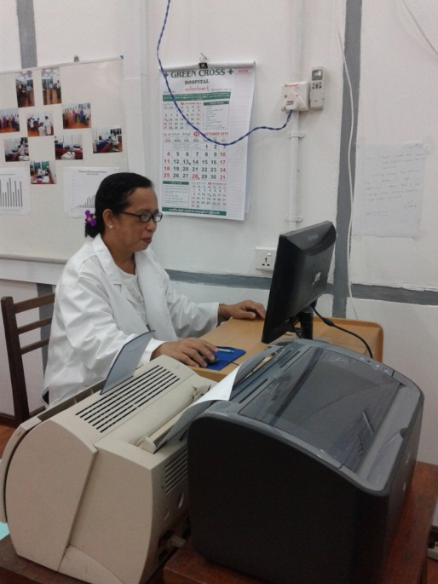
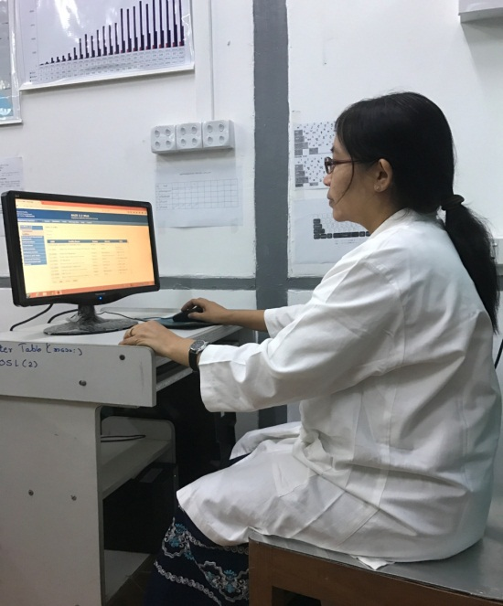
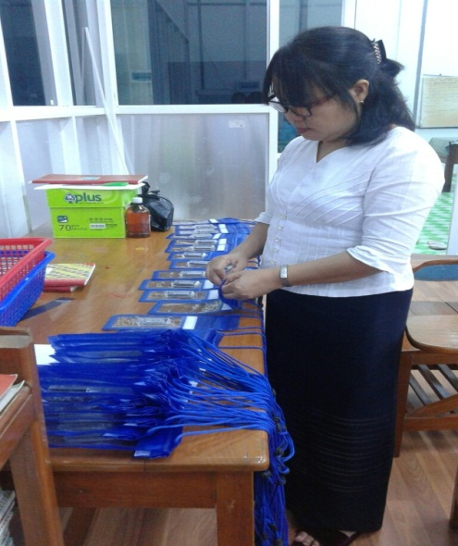
Processing and Evaluation

Slide 17
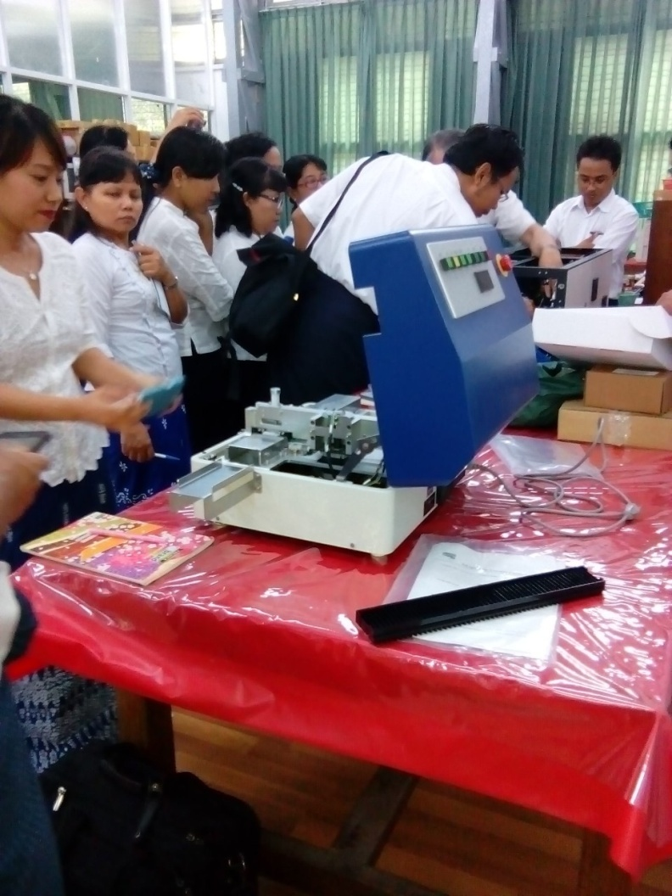
OSLD System Calibration and Training (2014)

Slide 18
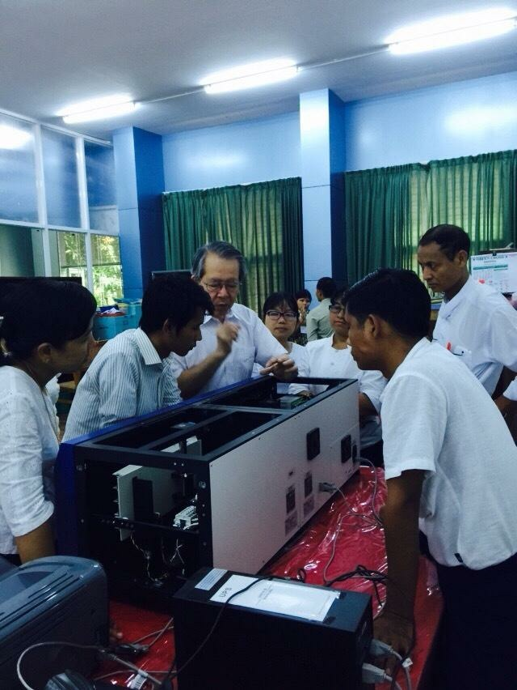
OSLD System Maintenance and Training (2015)

Slide 19
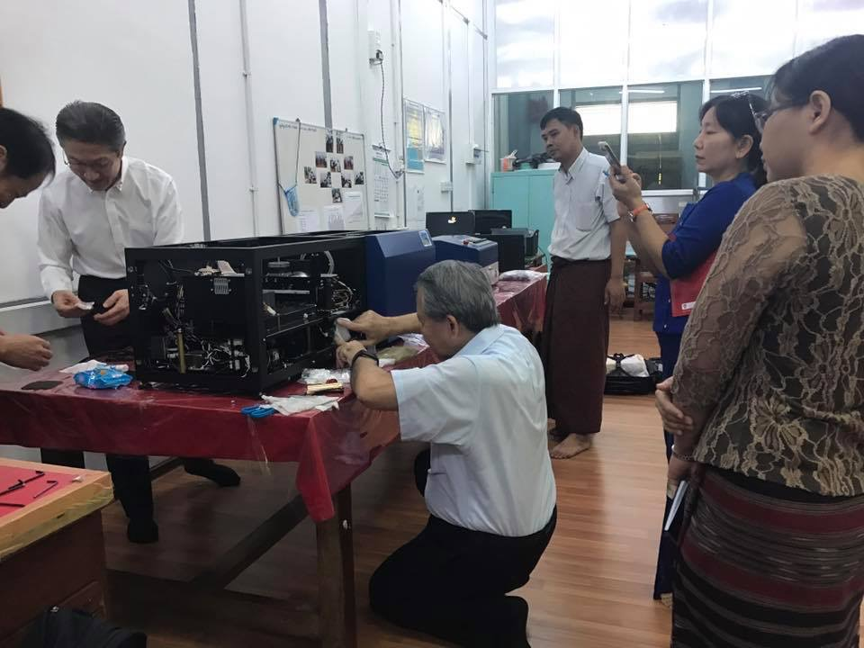
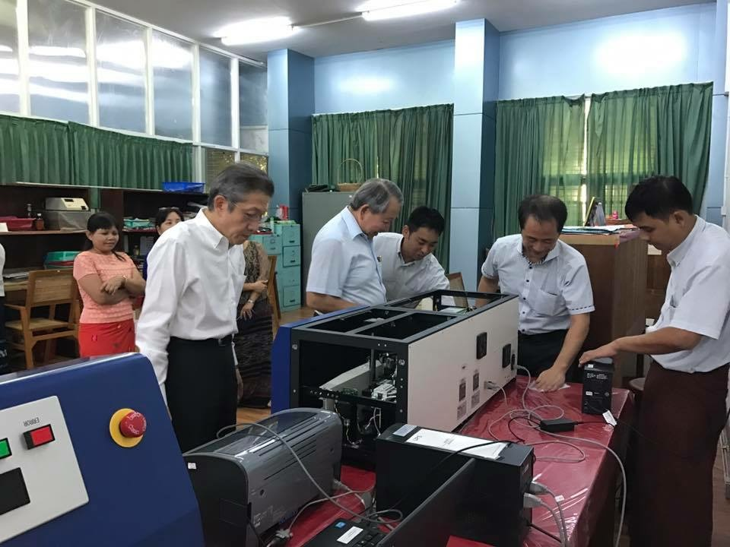
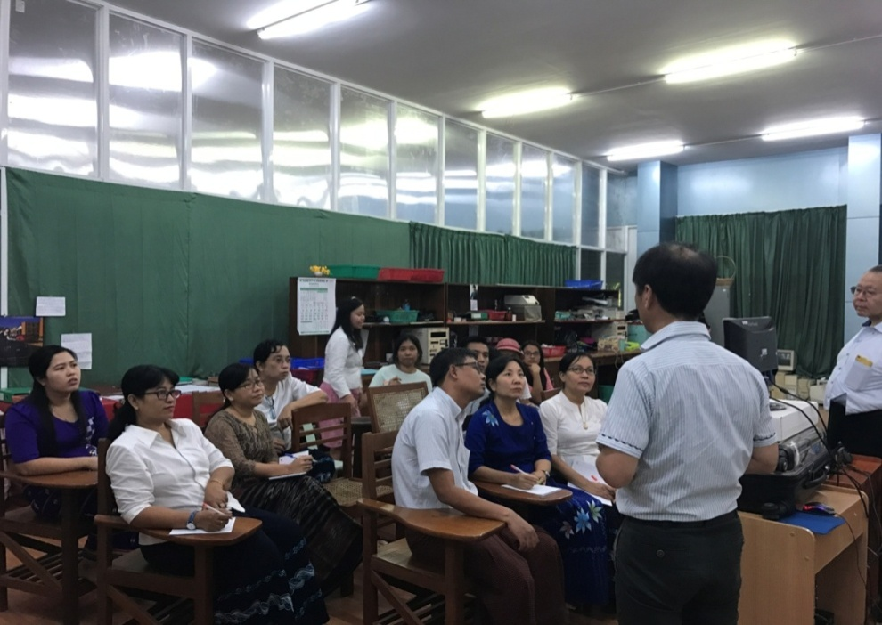
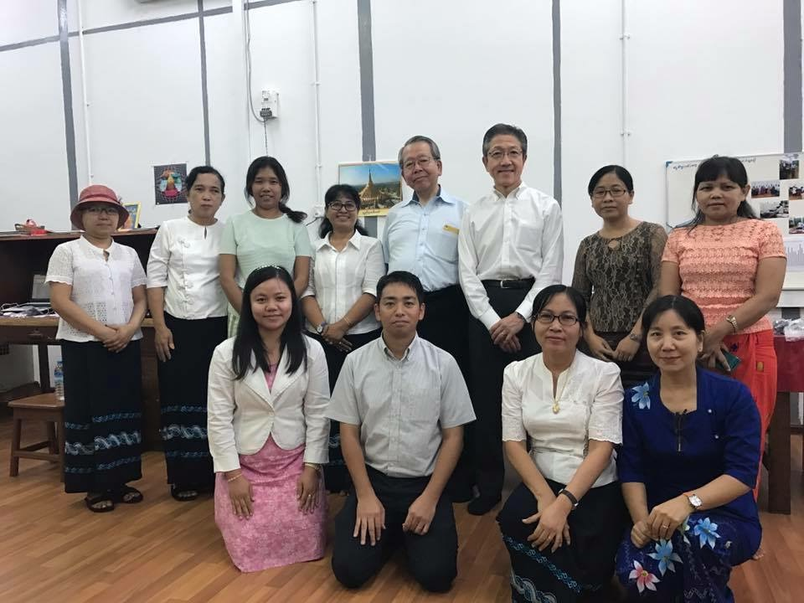
OSLD System Maintenance and Training (2016)

Slide 20
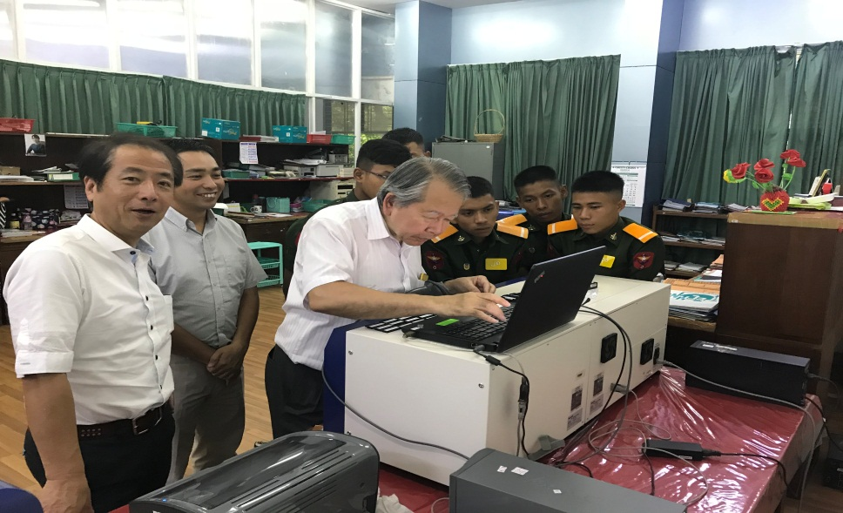
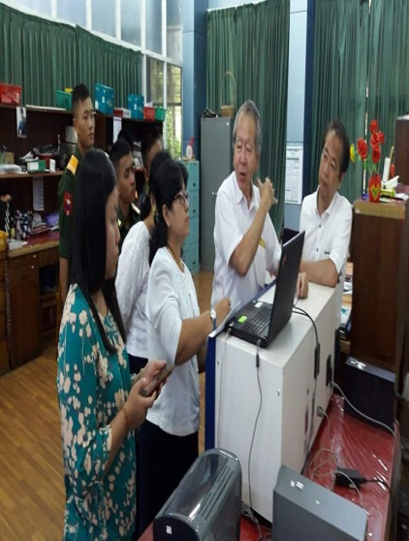
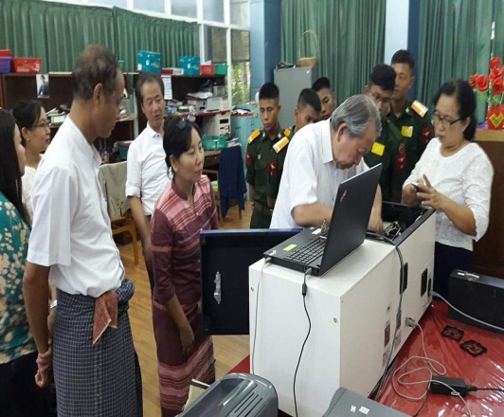
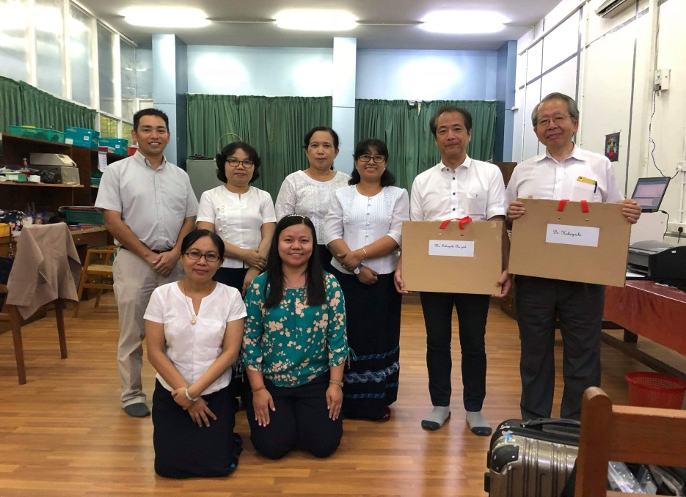
OSLD System Calibration and Maintenance (2018)

Slide 21
Problems AND Needs
Problems
OSLD Cards Insufficient
Limited Budget
Not return cards every two months regularly
Lost and damage (sometimes) occur
Needs
InLight Solution Reader and NA dosimeters
More XA dosimeters

Slide 22
Conclusion
Nowadays, radiations and nuclear technology is widely used in various fields such as medical, agriculture, industrial, education and research in Myanmar, radiation safety and security become important for all users and activities involving ionizing radiation.
Heart felt thanks to (OAP, Thailand) for inviting Myanmar to participate “Workshop on Building Asia-Pacific individual Monitoring Service ( IMS) Capabilities towards Regional Sustainable Network” which benefits for OSLD ( Myanmar) to get more experience of Inter-comparison program between countries.
OSL service will be upgraded in near future in Myanmar.
DAE will participate the OSL data inter-comparison program of IMS Laboratories network in Asia regularly.

Slide 23
Thank you very much for your kind attention!!!

