Slide 1
NAGASE PHILIPPINES CORPORATION
DOSIMETRY LABORATORY
Mara Isabel S. Tuvera

Slide 2
Tomohiko Ishiwatari
President/COO
ADMIN AND ISO ASSOCIATE
CUSTOMER SERVICE
ACCOUNTING AND FINANCE
Mara Tuvera
Physicist/OIC
Kohsuke Yamamoto
Deputy General Manager/Treasurer
Mary Anjenette Maaba
Sr. HR Associate
HUMAN RESOURCE
LABORATORY
Jennielyn B. Taldy
SALES AND MARKETING
Mary Ann delos Nieves
Assistant Sales Manager
Bien Carlos
Sales Executive
Mylene Liwag
Sales Assistant/Pharmacist
Michelle Luyun
Physicist/Lab Engineer
Leonora Dizon CS Associate
Ruby Baong
Accounting and Finance Associate
ORGANIZATION
STRUCTURE

Slide 3
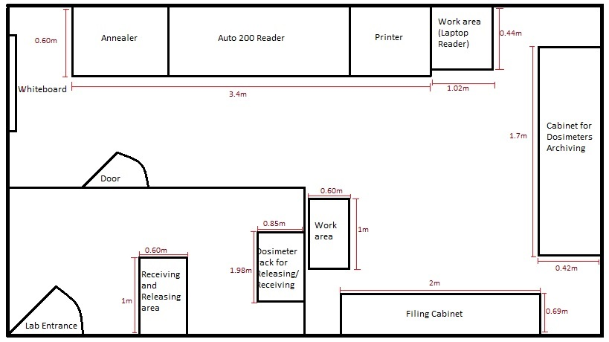
LABORATORY LAYOUT

Slide 4
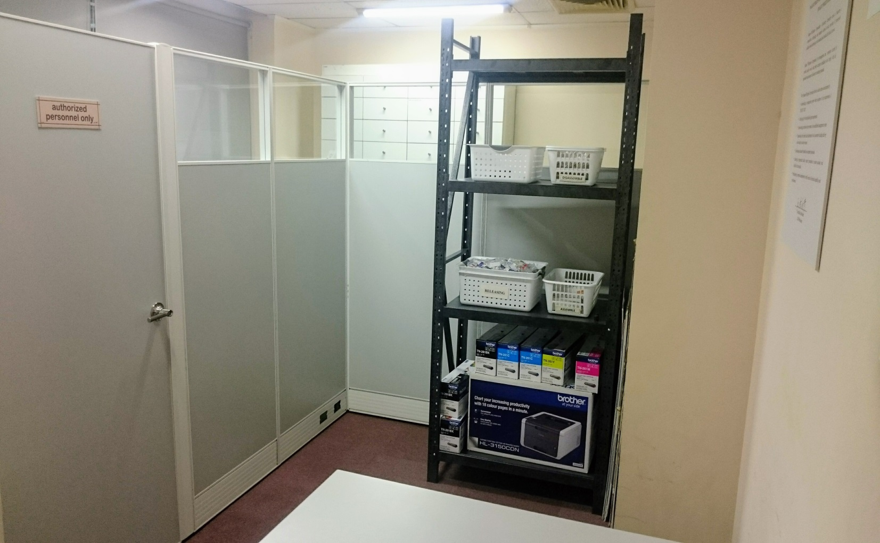
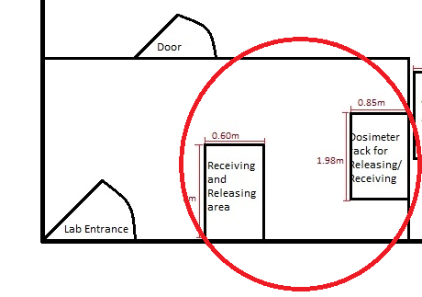
LABORATORY LAYOUT

Slide 5
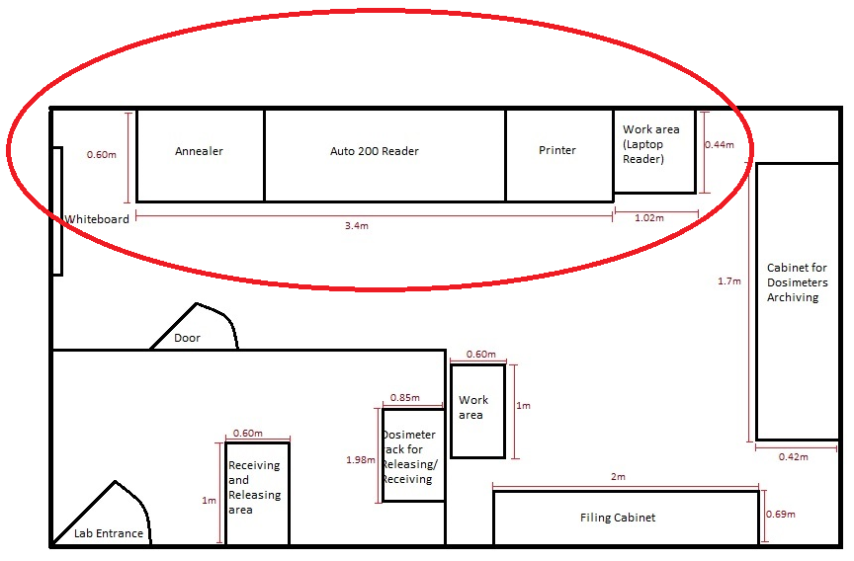
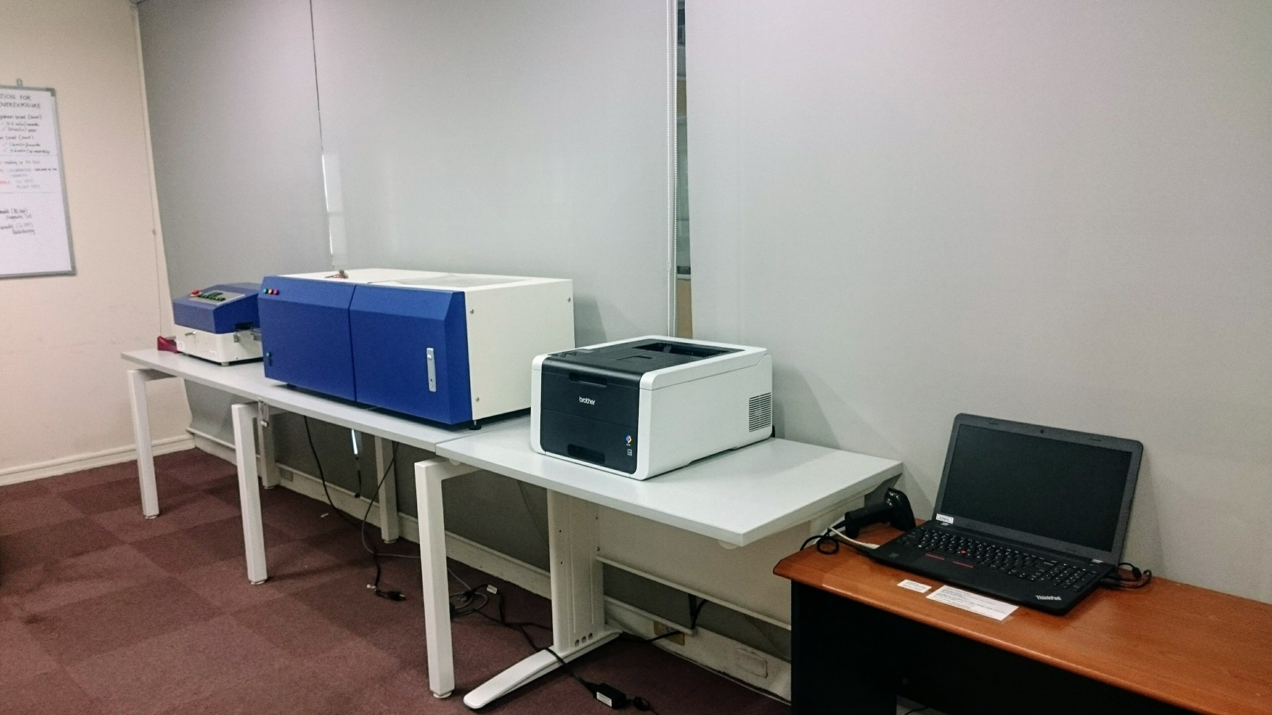
LABORATORY LAYOUT

Slide 6
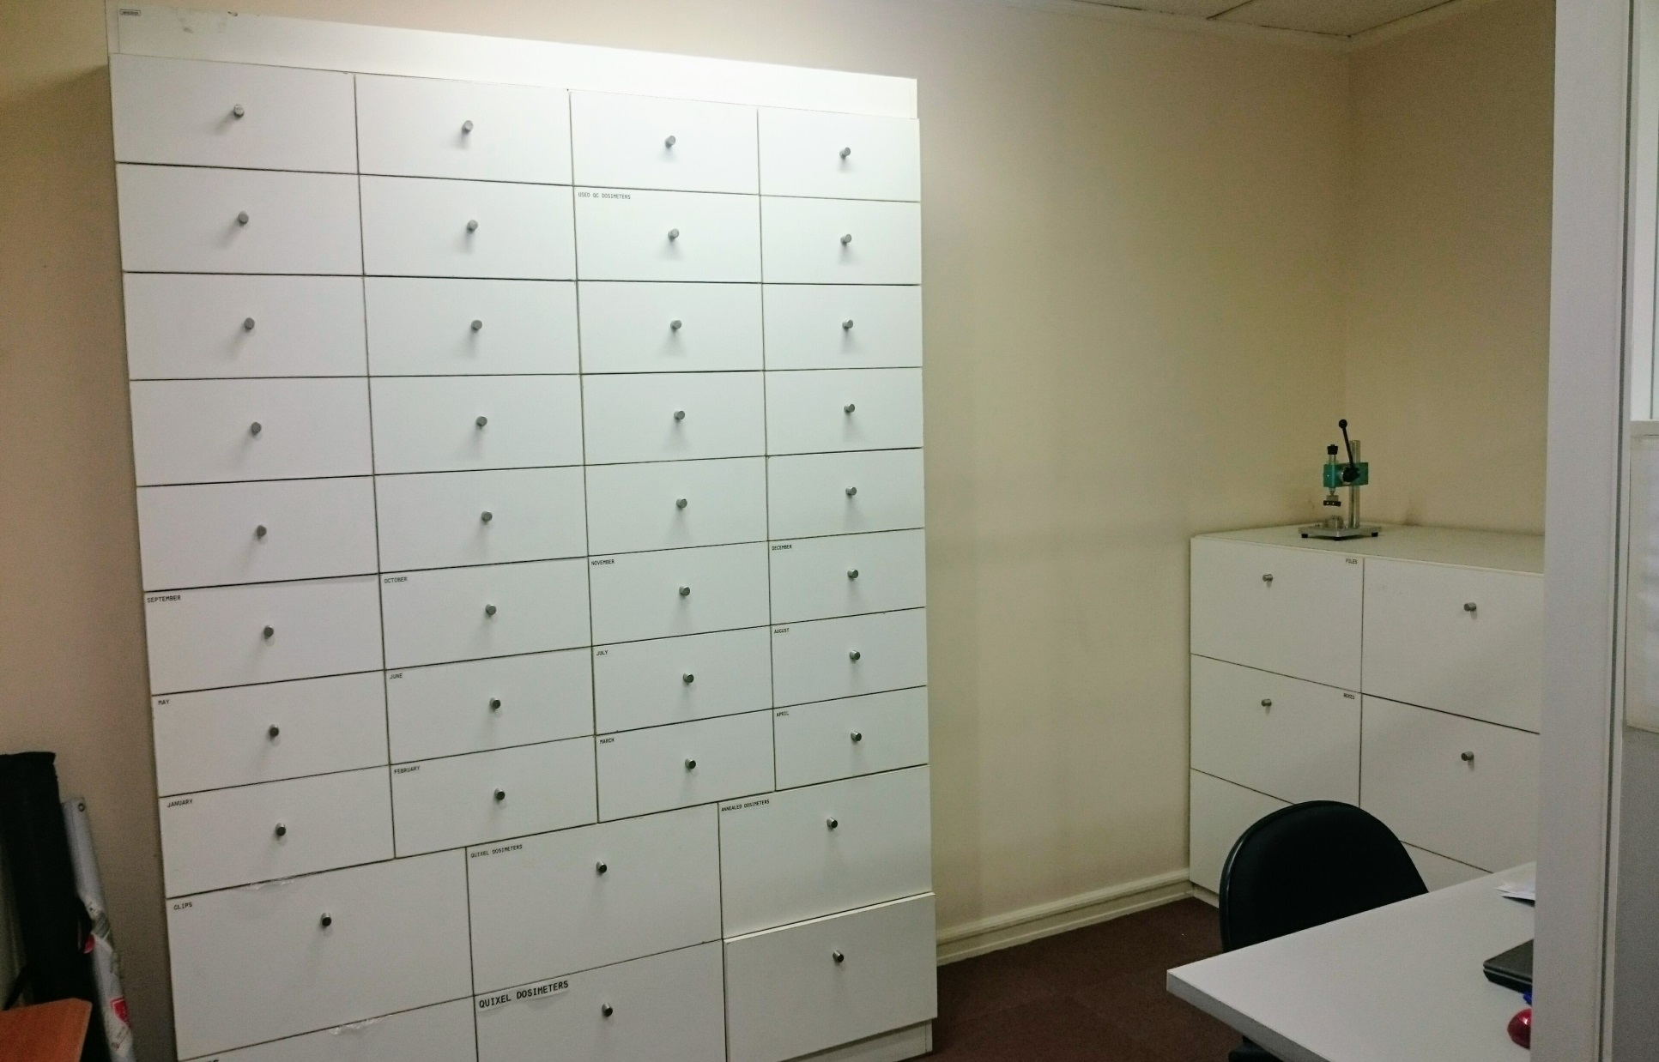
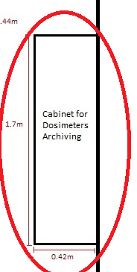
LABORATORY LAYOUT

Slide 7
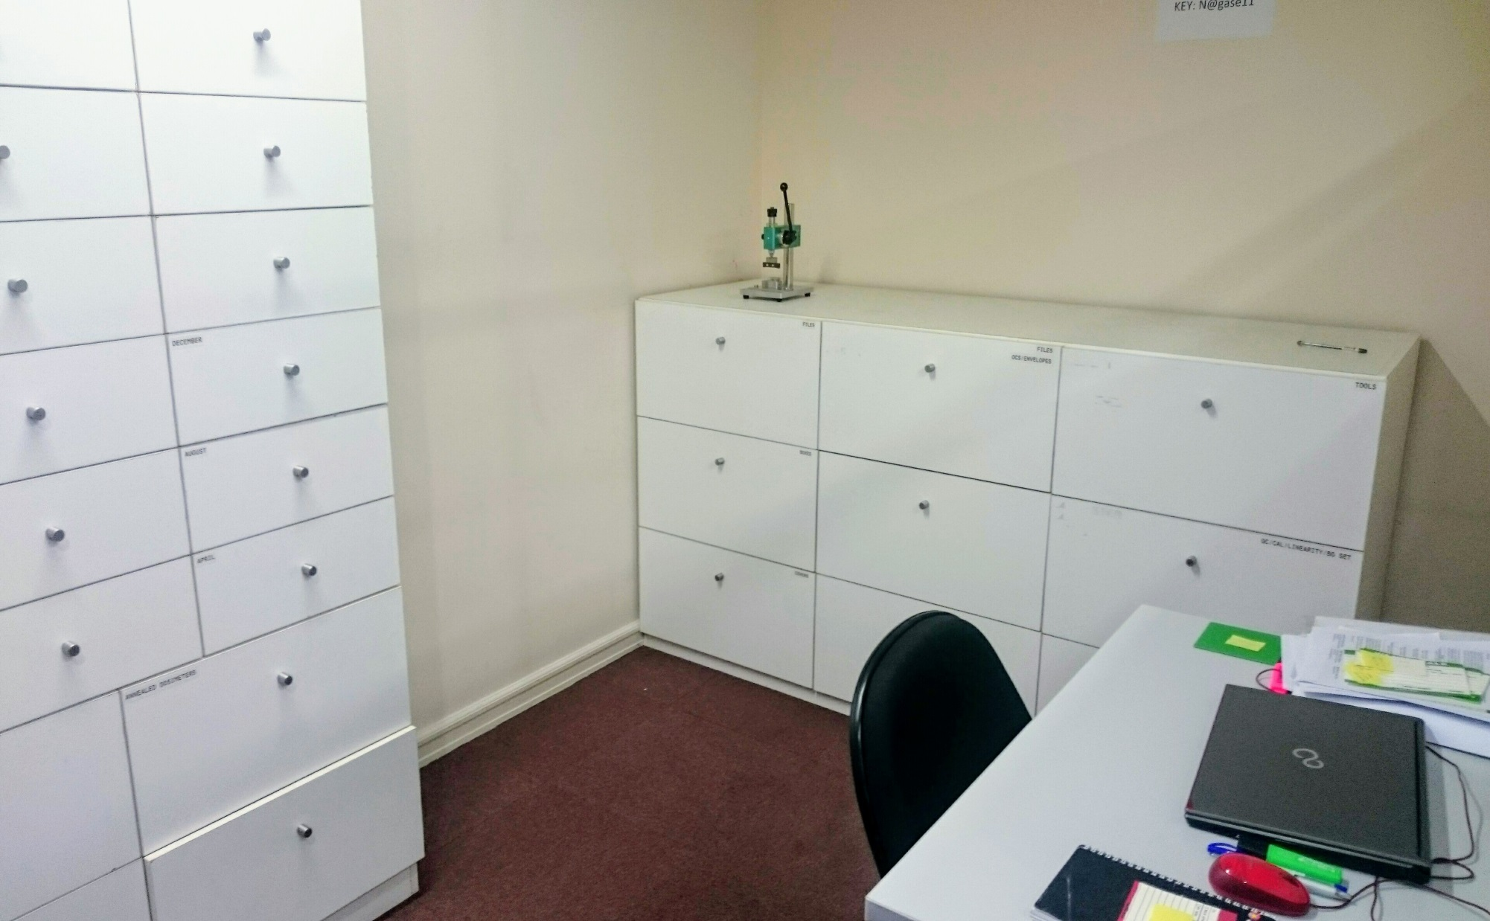
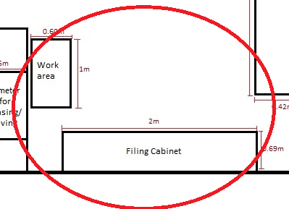
LABORATORY LAYOUT

Slide 8
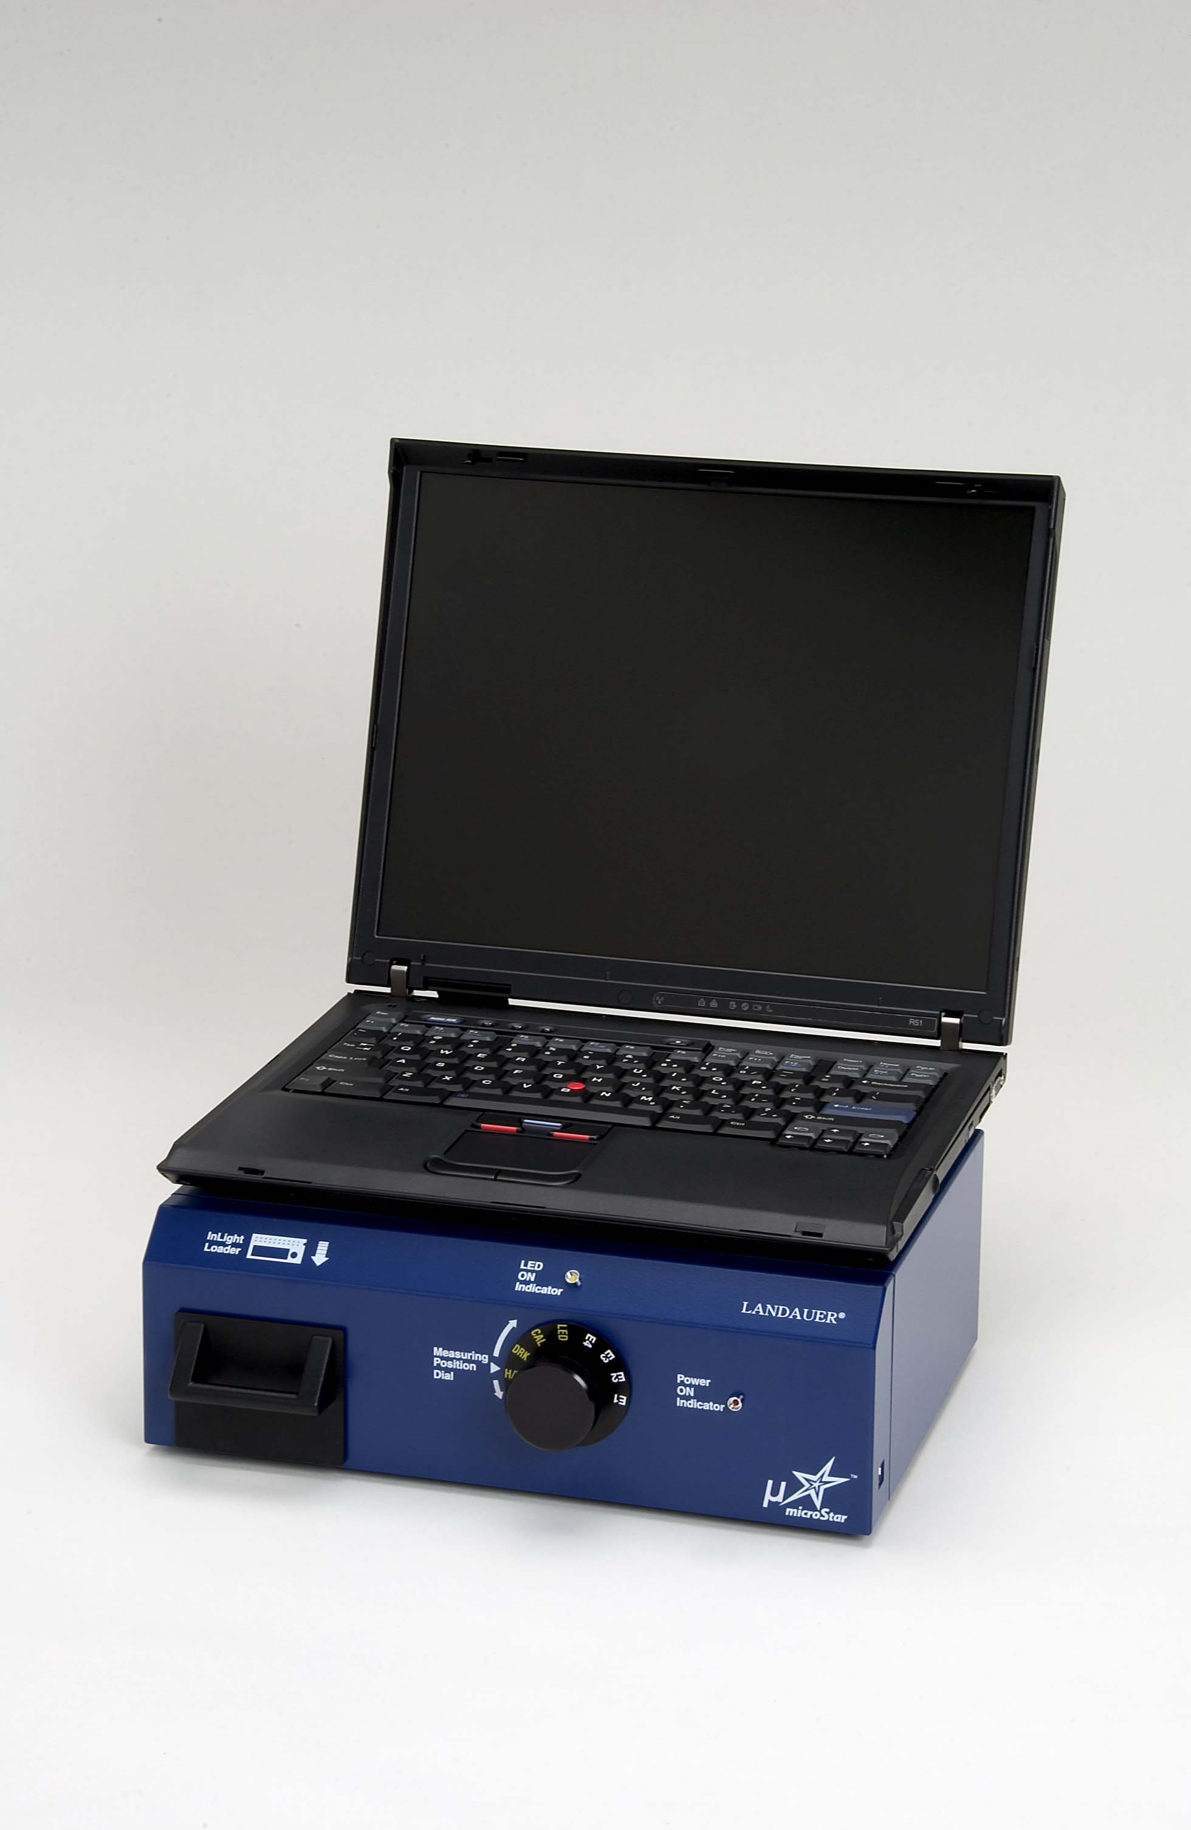
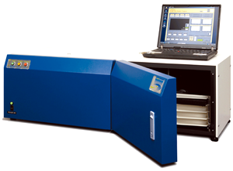
LABORATORY EQUIPMENT

Slide 9
METROLOGICAL TRACEABILITY
The calibration of our Calibrates, QC and Linearity set badges are directly traceable to NIST. The expanded uncertainty of 5% is the standard uncertainty of measurement at 95% confidence interval.

Slide 10
QA/QC PROGRAM
Calibration and Linearity test
QC test
Standard Measurement
Preventive Maintenance
External QC:
  Intercomparison c/o OAP

Slide 11
CURRENT NO. OF FACILITIES SERVICING
26 FACILITIES; 862 USERS
15 UPCOMING NO. OF FACILITIES; 300 USERS

Slide 12
UPDATES
MICROSTAR READER
TRANSITION OF ISO 17025:2005 TO 2017 VERSION

Slide 13


