Slide 1


JOINT IAEA/ARPANSA REGIONAL INTERCOMPARISON EXERCISE ON INDIVIDUAL MONITORING FOR EXTERNAL EXPOSURE - 2018
Stephen Long - ARPANSA
Presented by Duncan Butler to the Workshop on Building Asia-Pacific IMS Capabilities towards Regional Cooperation Network, Bangkok, 18-20 March 2019

Slide 2
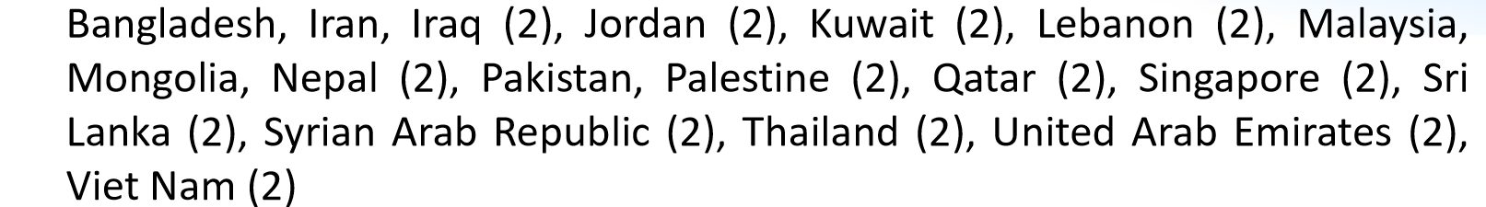
Participants
21 Countries
30 Individual monitoring services
  1 participant withdrew (instrument failure)
    29 completed questionnaires
  1 participant’s dosemeters damaged in transit
  4 participants’ dosemeters delayed by export restrictions
    24 sets of results submitted

Slide 3
Timeframes
Agenda | Timeframe | Activities
Official announcement and confirmation of participation | Announcement Jan 2018 Confirmation 1 June 2018 | IAEA & ARPANSA announce the Intercomparison Exercise
Sending of dosimeters | Dosimeters must arrive by July 30 | The participants send the dosimeters to ARPANSA
Irradiation | August 2018 | ARPANSA irradiates the dosimeters
Return of irradiated dosimeters | September 2018 | Irradiated dosimeters will be returned to the intercomparison participants for evaluation
Evaluation | September and October 2018 | Participants read and evaluate the irradiated dosimeters
Reporting | Must report by October 30 2018 | Participants report the result of evaluation
Evaluate the participants’ results | November 2018 | IAEA & ARPANSA evaluate the Participants’ reports and provide preliminary results
Evaluation Workshop & Finalization of Exercise Report | February 2019 | Discussion and report preparation

Slide 4
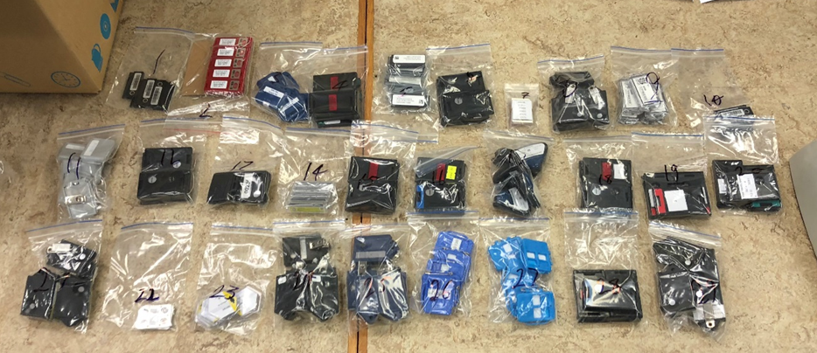
Measurement Technologies

Slide 5
Instrument Calibration

Slide 6
Measurement Traceability

Slide 7
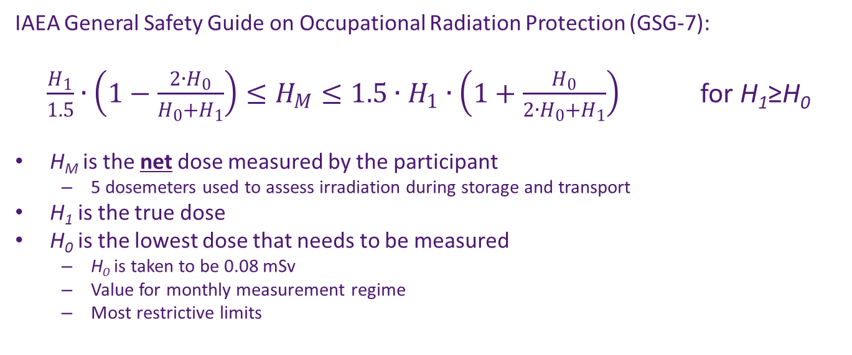
Assessment Methodology
IAEA General Safety Guide on Occupational Radiation Protection (GSG-7):
$\frac{H_{1}}{1.5}∙\left(1−\frac{2∙H_{0}}{H_{0}+H_{1}}\right)≤H_{M}≤1.5∙H_{1}∙\left(1+\frac{H_{0}}{2∙H_{0}+H_{1}}\right)$ for H₁≥H₀
H_{M} is the net dose measured by the participant
  5 dosemeters used to assess irradiation during storage and transport
H₁ is the true dose
H₀ is the lowest dose that needs to be measured
  H₀ is taken to be 0.08 mSv
  Value for monthly measurement regime
  Most restrictive limits

Slide 8
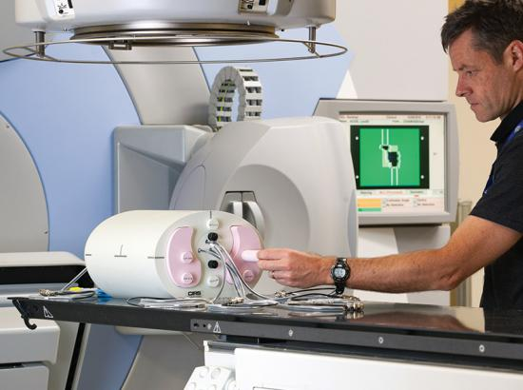
The Australian Primary Standard Dosimetry Laboratory
Primary standards for the dosimetry of ionisation radiation for Australia
Participates in intercomparison exercises with international metrology organisations
Calibration and Measurement Capabilities (CMCs) and comparison results are listed in the BIPM Key Comparison Database
Accredited against ISO Standard 17025 to provide exposures of personal dosemeters traceable to the Australian standard

Slide 9
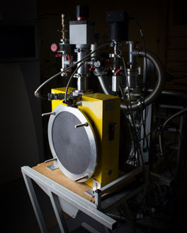
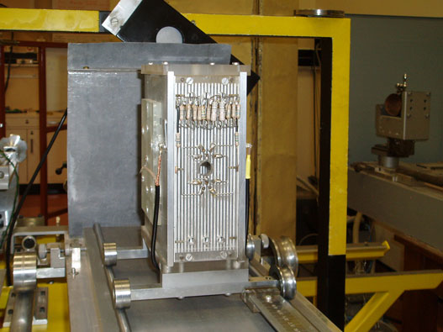
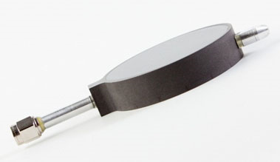
Australian Primary Standards
Primary standards are all detectors of radiation
  graphite calorimeter for megavoltage radiation
  two free air chambers for kilovoltage radiation
  graphite cavity chamber for determination of air kerma at ⁶⁰Co

Slide 10
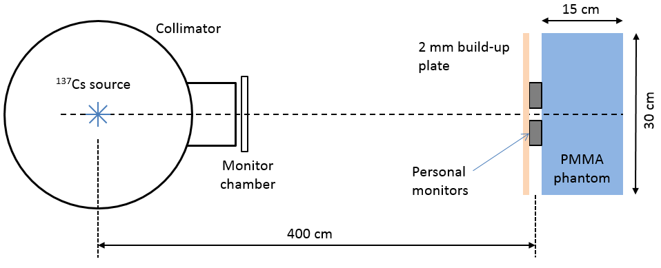
Irradiation to the ¹³⁷Cs Beam
Direct teletherapy Cs beam (no attenuators added)
Distance 4 m
Beam diameter 40 cm
PMMA slab phantom 30 x 30 x 15 cm
2 mm PMMA added over the front of the monitors
Nominal Hp(10) rate of 35 µSv/s
Conversion from air kerma:
  1.21 Sv/Gy at 0°
  1.22 Sv/Gy at 20°
    ISO 4037 Part 3 Table 33
Hp(10) delivered:
  3.18 mSv at 0°
  3.21 mSv at 20°
Nominal relative uncertainty (k=2): 6%
Traceability: Via Farmer Chamber calibrated at Co-60 and MEX against ARPANSA primary standard, and interpolated to Cs-137

Slide 11
Measurement of Exposure to the ¹³⁷Cs Beam at Normal Incidence
Exposure: 3.18 mSv
Lower Limit: 2.01 mSv
Upper Limit: 4.89 mSv
Only 54% of results within confidence interval

Slide 12
Measurement of Exposure to the ¹³⁷Cs Beam at 20° Incidence
Exposure: 3.21 mSv
Lower Limit: 2.03 mSv
Upper Limit: 4.93 mSv
Only 50% of results within confidence interval

Slide 13
Overlay: 0° and 20°

Slide 14
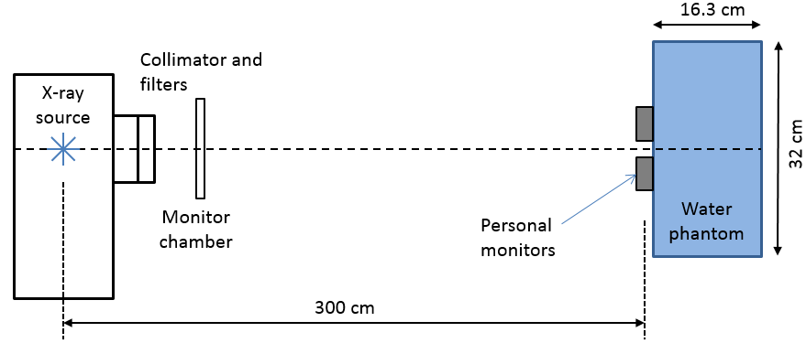
Irradiation to the X-ray Beam
Constant potential, tungsten target X-ray tube
Beam quality 70 kVp, 15 mA
Additional filtration: 4 mm Al, HVL = 3.19 mm Al (approx. 0.11 mm Cu)
Effective energy ~34 keV for Cu
Similar to PTB therapy beam, code TH 70
Distance 3 m
Beam diameter 45 cm
Water slab phantom 30 x 30 x 15 cm of water
  outer 32 x 32 x 16.3 cm including PMMA walls
No PMMA added over the front of the monitors
Conversion from air kerma:
  1.47 Sv/Gy at 0°
  1.44 Sv/Gy at 20°
    ISO 4037 Part 3 Table 27
Hp(10) delivered:
  5.44 mSv at 0°
  5.34 mSv at 20°
Nominal relative uncertainty (k=2): 6%
Traceability: Via large area transmission chamber calibrated directly against the primary standard of MEX air kerma

Slide 15
Measurement of Exposure to the X-ray Beam at Normal Incidence
Exposure: 5.44 mSv
Lower Limit: 3.52 mSv
Upper Limit: 8.28 mSv
Only 25% of results within confidence interval

Slide 16
Measurement of Exposure to the X-ray Beam at 20° Incidence
Exposure: 5.34 mSv
Lower Limit: 3.45 mSv
Upper Limit: 8.13 mSv
Only 25% of results within confidence interval

Slide 17
Overlay: 0° and 20°

Slide 18
Assessment of Uncertainty
Did not report uncertainty
Uncertainty < standard deviation
Notes:
4 participants did not report uncertainties.
4 participants reported uncertainties smaller than the standard deviation in the results.

Slide 19
Conclusions
All laboratories were within the tolerance
Several laboratories were close to the limit…
Many measurements were not within stated uncertainty of the “true” value
Uncertainties were often under-estimated (or missing)

Slide 20



THANK YOU
CONTACT ARPANSA
Email: info@arpansa.gov.au
Website: www.arpansa.gov.au
Telephone: +61 3 9433 2211
Freecall 1800 022 333
General Fax: +61 3 9432 1835

