Slide 1
Hp(10) irradiations for personal dosimetry traceability
Duncan Butler
Workshop on Building Asia-Pacific Individual Monitoring Service (IMS) Capabilities toward Regional Sustainable Network.
At Pullman Bangkok King Power Hotel, Bangkok Thailand 18-20 March 2019

Slide 2
Quantity H_{p}(10)
Personal dose equivalent, H_{p}(d)
= Absorbed dose to soft tissue at depth of d mm at a specified point in the body
Note: For weakly penetrating radiation d = 0.07 mm is of interest (“skin dose”)
For strongly penetrating radiation, d = 10 mm is of interest

Slide 3
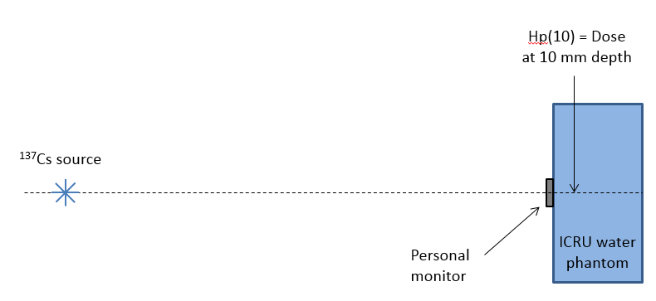
In calibration laboratory…
Radiation source

Slide 4
Comment
Regulations mostly refer to “Effective dose”
This quantity includes:
assumption: radiation incident from everywhere
dose throughout the human body
organ risk factors
Very to hard to measure!
Personal dose equivalent, such as Hp(10), is an operational quantity – it can be
measured
Used as a surrogate for effective dose

Slide 5
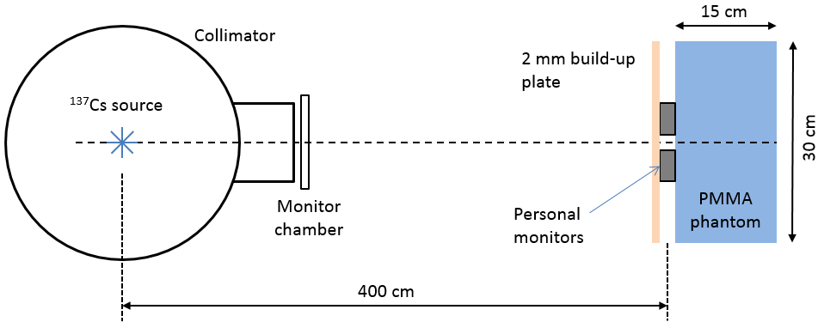
Irradiation to the ¹³⁷Cs Beam
Direct teletherapy Cs beam (no attenuators added)
Distance 4 m
Beam diameter 40 cm
PMMA slab phantom 30 x 30 x 15 cm
2 mm PMMA added over the front of the monitors
Nominal Hp(10) rate of 35 µSv/s
Conversion from air kerma:
1.21 Sv/Gy at 0°
1.22 Sv/Gy at 20°
ISO 4037 Part 3 Table 33
Nominal relative uncertainty (k=2): 6%
Traceability: Farmer Chamber calibrated at Co-60 and X-rays against ARPANSA primary standards, and interpolated to Cs-137

Slide 6
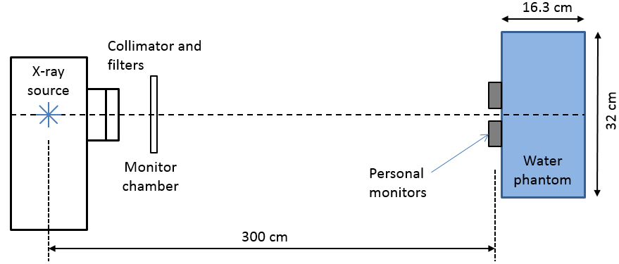
Irradiation to the X-ray Beam
Constant potential, tungsten target X-ray tube
Beam quality 70 kVp, 15 mA
Additional filtration: 4 mm Al, HVL = 3.19 mm Al (approx. 0.11 mm Cu)
Effective energy ~34 keV for Cu
Similar to PTB therapy beam, code TH 70
Distance 3 m
Beam diameter 45 cm
Water slab phantom 30 x 30 x 15 cm of water
outer 32 x 32 x 16.3 cm including PMMA walls
No PMMA added over the front of the monitors
Conversion from air kerma:
1.47 Sv/Gy at 0°
1.44 Sv/Gy at 20°
ISO 4037 Part 3 Table 27
Nominal relative uncertainty (k=2): 6%
Traceability: Via large area transmission chamber calibrated directly against the primary standard of medium-energy X-ray air kerma

Slide 7
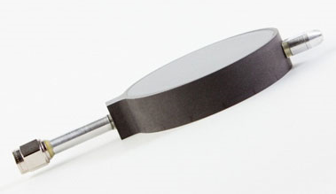
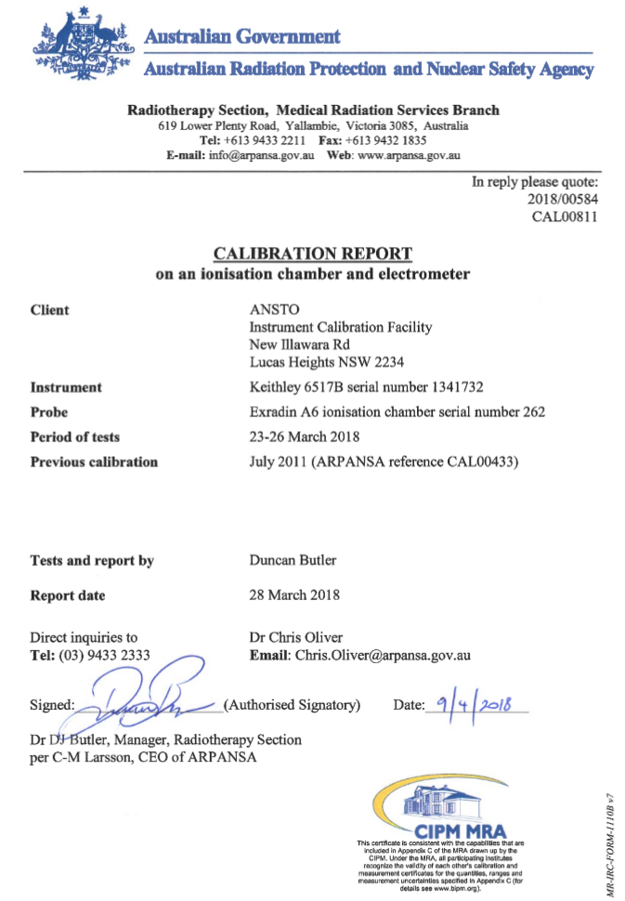
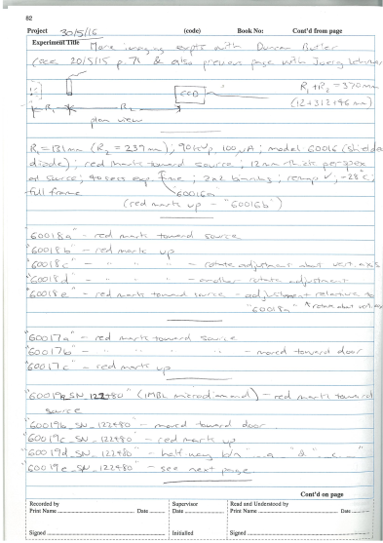
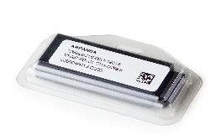
What does “traceability” mean?
Traceability = Documented chain of measurements
A primary standard of radiation dose
The radiation measurement you make

Slide 8
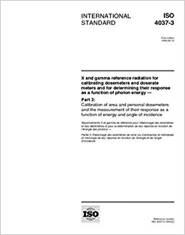
ISO 4037 – irradiation of personal monitors to Hp(10)
Issued in 1999
4 parts
Updated in 2019
Tells laboratories how to irradiate monitors
to Hp(10) etc

Slide 9
ISO 4037 (1998) – irradiation of personal monitors to Hp(10)
Determine air kerma K (free in air) at reference distance (say 3 m)
Put the monitor on the ICRU slab phantom
Adjust reference point of dosimeter to be at reference distance
Cover with PMMA (2 mm for ¹³⁷Cs or 4 mm for ⁶⁰Co)
Use ISO 4037 conversion coefficient to obtain Hp(10) from K

Slide 10
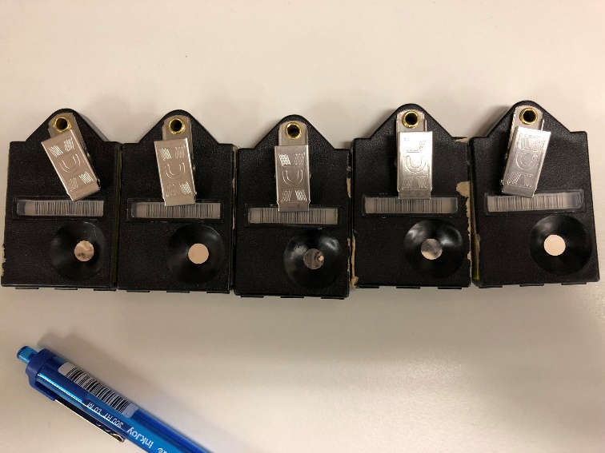
In the IAEA-ARPANSA comparison…
29 dosimetry services
2 beam qualities
2 angles
5 monitors per beam and angle
29 x 2 x 2 x 5 = 580 monitors to irradiate!
Have to irradiate in groups of 2 or 3
Exposure times ~ a few minutes each
Laboratory time taken = 3 days

Slide 11
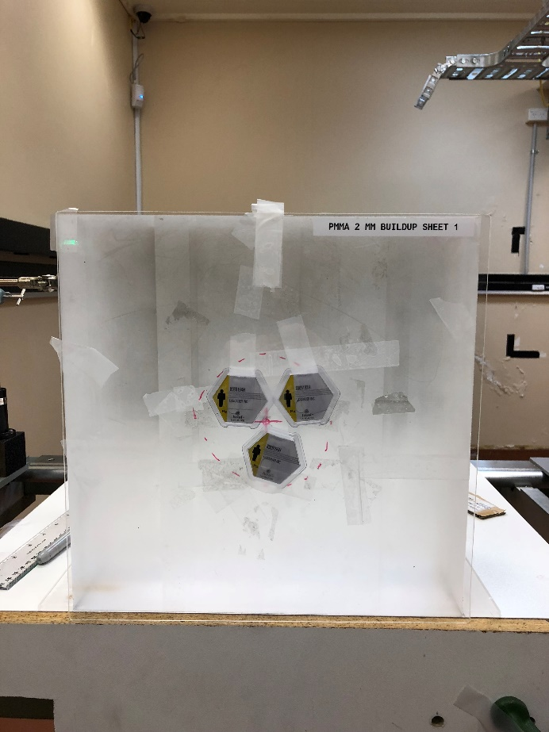
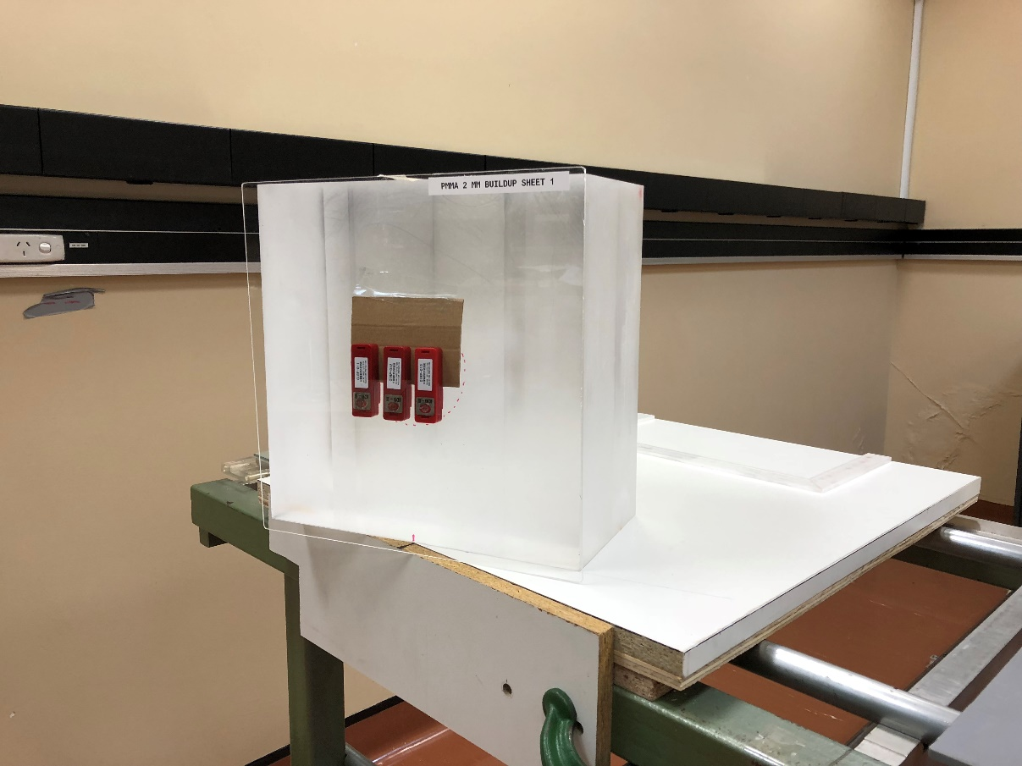
(Added uncertainty due to monitor proximity to each other)
0°
20°

Slide 12
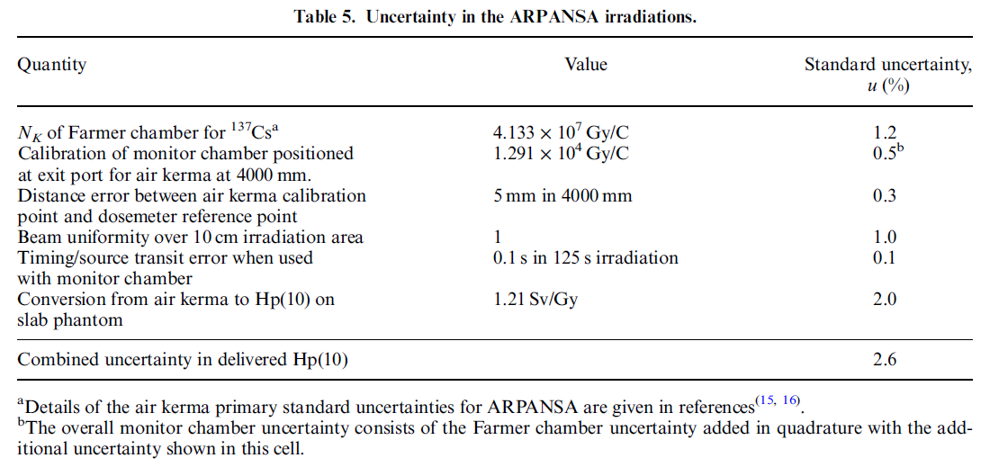
Uncertainty budget for primary standard laboratory for single monitor irradiation

Slide 13
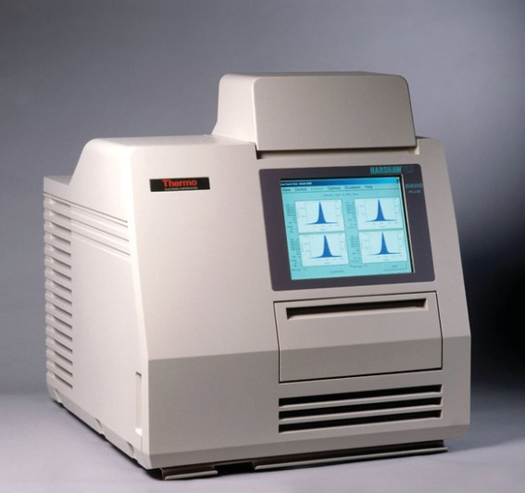
Uncertainty budget
Calibrate reader
Primary standard
Irradiated reference monitors
(What energy? What dose? How many?)
Wearer
(~3 months)
Read monitor, D_{mon}
Subtract background!
Occupational dose
to wearer, D

Slide 14
Source of uncertainty
Primary or secondary standard
Dose given to reference monitors
Uncertainty in calibration of reader
Variation in reading out the reference monitors

Slide 15
Source of uncertainty
Reader calibration
Energy response
Uncertainty in dose readout
Linearity
Fading
Statistical variation for one monitor

Slide 16
Source of uncertainty
Uncertainty in occupational dose
Dose readout
Background
D_{mon} - B
Over 3 months, can have a large variation!

Slide 17
Statistical uncertainty
5 reference monitors
All irradiated to same dose (1 mSv) by standards laboratory
Readout gives 1.2 mSv, 1.4 mSv, 0.6 mSv, 1.1 mSv, 1.2 mSv
Average = 1.1 mSv
Standard deviation = 0.3 mSv
Standard deviation of the mean = 0.3 / sqrt(5) = 0.13 mSv

Slide 18
Statistical uncertainty
Standard deviation = 0.3 mSv
Is the estimate of the uncertainty in one reading
Standard deviation of the mean = 0.3 / sqrt(5) = 0.13 mSv
Is the estimate of the uncertainty in the average
of the 5 readings

Slide 19
THANK YOU
CONTACT ARPANSA
Email: info@arpansa.gov.au
Website: www.arpansa.gov.au
Telephone: +61 3 9433 2211
Freecall 1800 022 333
General Fax: +61 3 9432 1835

