Slide 1
Report: Dosimetry activities in Dalat Nuclear Research Institutes
Reporter: le viet phong
Radiation protection center nuclear research institute
Dalat, viet nam

Slide 2
1. History & Organization Structure
1960 - 1968:
Dalat Nuclear Reactor (DNR) was build by US & South VN gov
(TRIGA Mark II; 250 kW)
Oct,9th,1979: VN & Soviet’s aggerment: Recovery to DNR
March, 20th, 1984:
Inaugural & operation official
(renamed DNR to Dalat Nuclear Research Institute)
Present(2019):
About 35 year development
1968 - 1975:
Nuclear Reactor had stopped working for the War
1979 - 1983:
Recovery and expand DNR
(renamed IVV-9; 500 kW)
2007 – 2011:
Fuel change HEU to LEU

Slide 3
1. History & Organization Structure
Purpose:
Research and nuclear application: radioisotope production, nuclear data analysis, chemical analysis, NAA, radiation protection service, environment analysis, biological, mutation radiation, radiation waste management, etc.
Structure of Organization:
Dalat NRI includes:
9 research center and 3 department
145 radiation staff

Slide 4
LEADERSHIP
Reactor Center
Radiation Protection Center
Center for Research and Production of Radioisotope
Physical & Electronics Center
Analysis Center
Environment Center
Biological Center
Radiation Technical Center
Administrative Department
Education Center
Planning & International Cooperation Department
Quality management Department

Slide 5
2. Facilities and environment condition
Radiation risk: neutron; gamma; beta; alpha & beta and X-ray
Radiation protection center (RPC) responses radiation protection activities in DNRI
RPC includes 15 people, separate 2 teams: internal personnel dosimetry & external personnel dosimetry.
Main work include: routine task in DNRI & service for other facilities in radiation protection filed

Slide 6
Radiation Protection center
RPC performs routine task (in DNRI):
Radiation monitoring in reactor area and laboratories
Contaminate control, emission concentration control
Accounting & management for radiation source
Measure & management for individual dose for radiation staff
Operation for internal standard dosimetry laboratory
RPC services (other facilities):
Verification & accreditation for diagnostic imaging devices (X-ray machine, CT…)
Radiation safety assessment for radiation facilities
Measure & management for individual dose for radiation facilities.

Slide 7
3. Dosimetry method
Internal personnel dosimetry:
Measure unsealed radioisotopes of I-131, P-32 by the methods of measuring radioactive activities in human urine. Monthly, monitoring internal dose for 15 workers who produced and extracted radioisotopes in DNRI.
External personnel dosimetry:
RPC manufactures Thermoluminescent dosimeter using CaSO4:Dy which measured Hp(10) quantity.
In 2017, RPC startup the Landauer Inlight Dosmimeter system with Optically stimulated luminescence which measured Hp(0.07); Hp(3)&Hp(10)

Slide 8
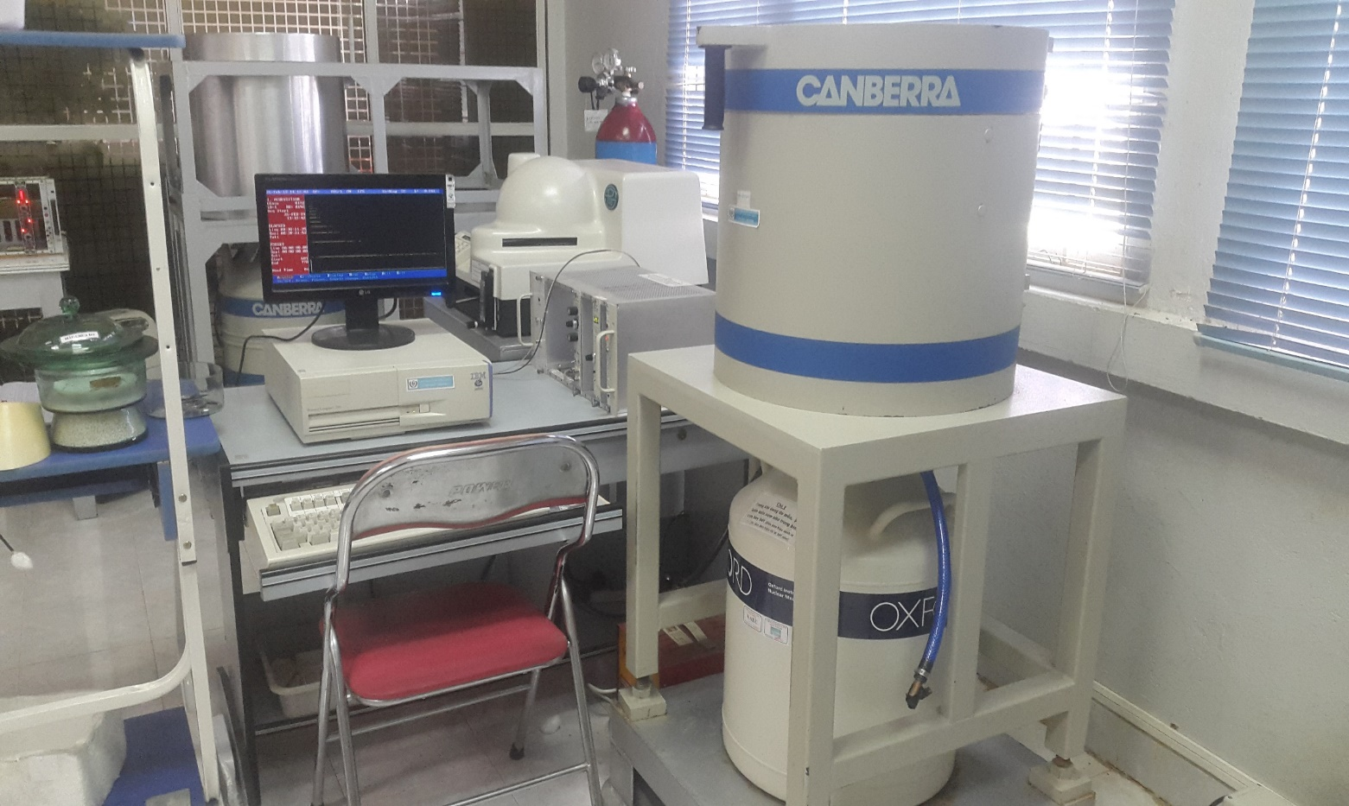
4.Equipment
Internal personnel dosimetry:
- Use Prompt Gama Activation Analysis (PGAA) methods with HPGe detector and low background
- Could be determine radioactivity in worker’ urine in DNRI

Slide 9
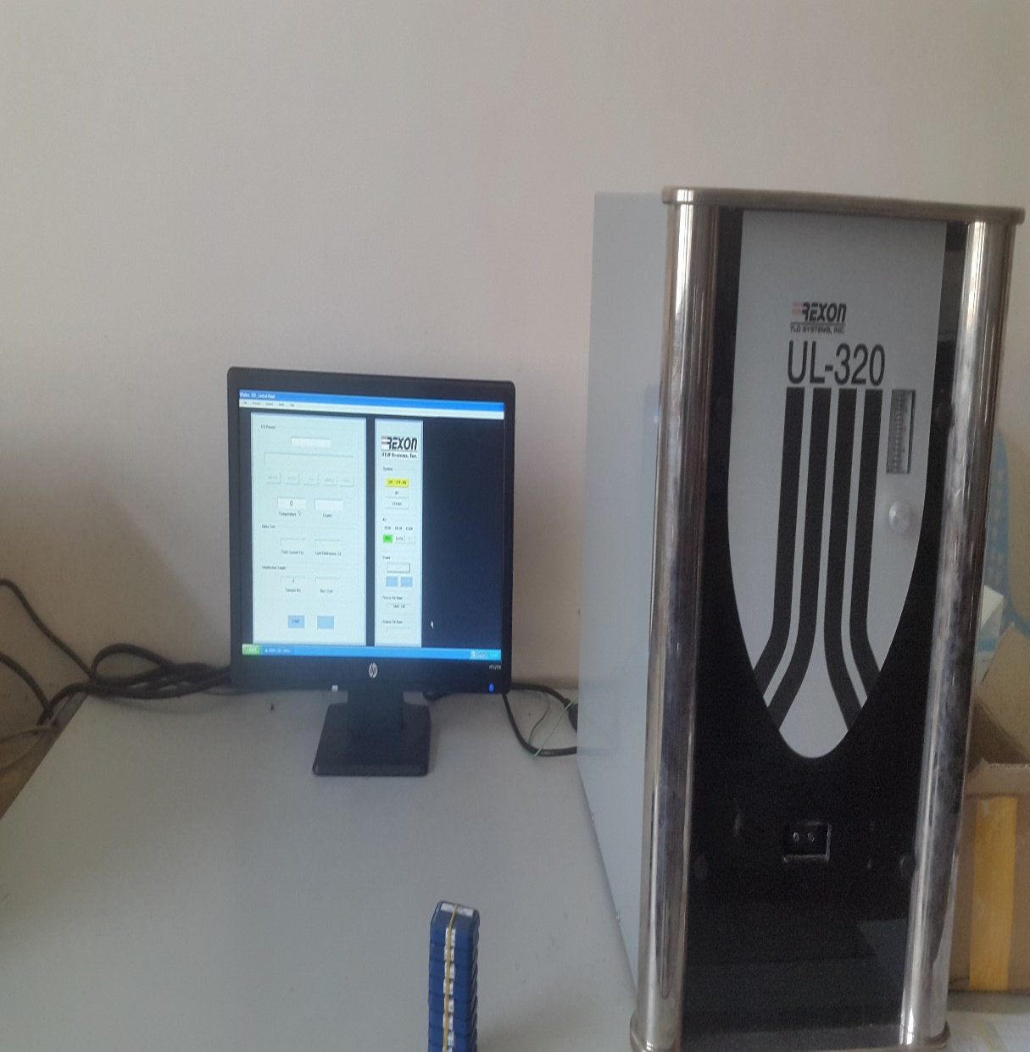
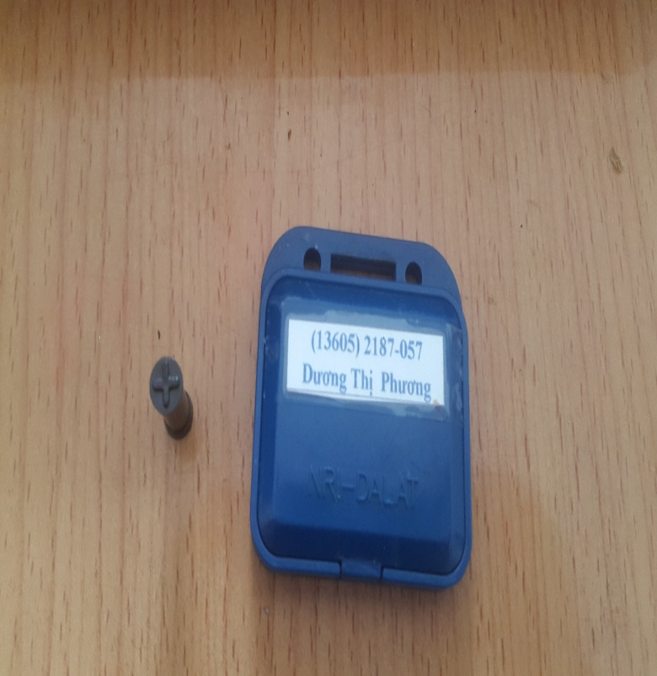
4.Equipment
External personnel dosimetry:
- TLD CaSO4:Dy powder manufactured by RPC, the reader use Rexon UL-320
- Could be determine quantity Hp(10),
- Each month, calibration factor determine by Cs-137 in the internal standard dose

Slide 10
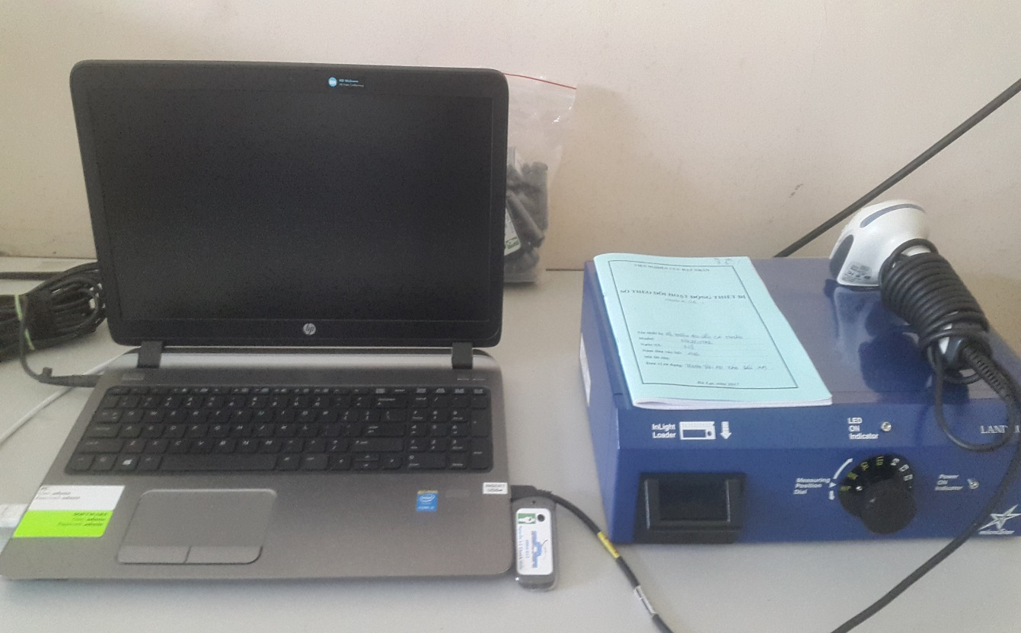
4.Equipment
External personnel dosimetry (cont’):
- Microstar system have started operation in 2017 use OSL dosimeter with Al2O3:C. Manufacture by Laundeur Inc.
Determine quantities Hp(10); Hp(0.07) & Hp (3)
Support for radiation staff who works with radioisotopes or unseal radiation source

Slide 11
5. Metrological Traceability
PGAA system
RS-G -1.2
Management individual dose database:
ISO 9001:2015
IEC 1061:1991
(TLD)
IEC 62387:2012
(OSL)
Determine uncertain by RS-G-1.3
Thermoluminesce dosimeter & Rexon Reader
Optical Stimulate Dosimeter & Microstar Reader
Note:
RS-G-1.2 Assessment of Occupational Exposure Due to Intakes of Radionuclides publication by IAEA
RS-G-1.3 Assessment of Occupational Exposure Due to External of Sources of Radiation publication by IAEA
IEC 1061:1991 Thermoluminescence Dosimetry Systems for Personal and Environmental Monitoring publication by IEC
IEC 62387:2012 Radiation Protection Instrumentation-Passive Integrating Dosimetry System for Personal and Environment Monitoring of Photon and Beta Radiation publication by IEC
ISO 9001:2015 Quality management system

Slide 12
6.QA&QC
SSDL
Standard Transfer Dosimetry
Internal
SDL
Every year, Internal SLD transferred standard with the system: Famer Dosimeter type 2570
Monthly, a mount of powder CaSO4 and a few OSLDs irradiates with Cs-137. After then, calculation a calibration factor for dosimeters and readers.
For X-ray, dosimeters irradiates with X-ray narrow spectrum in SSDL,INST, Hanoi.
Calculation calibration factor for dosimeter

Slide 13
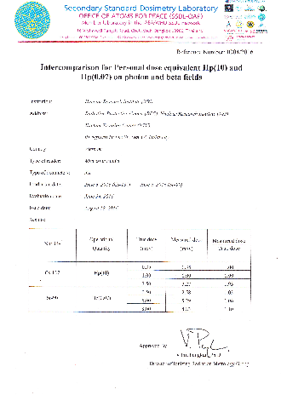
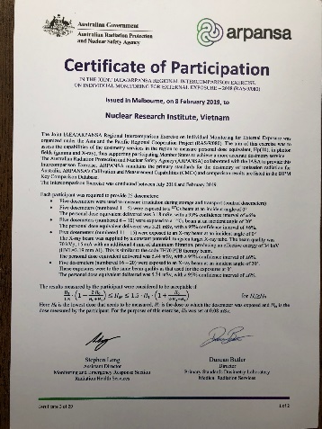
6. QA&QC
Every year, Vietnam Agency of Radiation and Nuclear Safety (VARANS) co-operations with SSDL establish the inter-comparison with the facilities which perform external personal dosimetry.
Other hand, DNRI performed the inter-comparison established by OAP & APANSA
SSDL
VARANS
OTHER
FACILITIES
DNRI

Slide 14
7. Number of Service
Statistics in 2018:
RPC has provided service of external personnel dosimetry about 5200 workers of 470 radiation installations in Vietnam.
Include: 317 OSLD for workers who have radiation risk with unseal source (3 months/times); about 5000 TLDs for radiation staffs who work with seal source and environment monitoring in installations (3 months/times)
Samsung Vietnam has the biggest number of radiation worker about 1000 staff (radiation risk: X-ray, use TLD).

Slide 15
8. Problem/ Needs
Keeping the inter-comparison program and upgrade to more quantities Hp(3).
For demand of radiotherapy in hospital, RPC needs support in external dosimetry with high energy beam.
In future, DNRI needs support about neutron dosimetry

Slide 16
THANK YOU FOR YOUR ATTENTION !

