Slide 1
CENTRE FOR APPLICATIONS OF NUCLEAR TECHNIQUE IN INDUSTRY Reporter: Nguyen Ngoc Nhat Anh

Slide 2
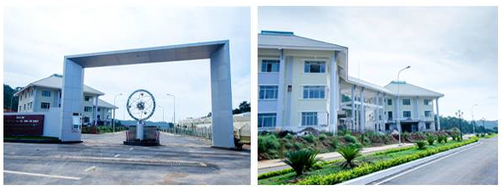
INTRODUCTION
Centre for Applications of Nuclear Technique in Industry (CANTI)
Address: 01, DT 723, Ward 12, Dalat, Lamdong, Vietnam.
www.canti.vn

Slide 3
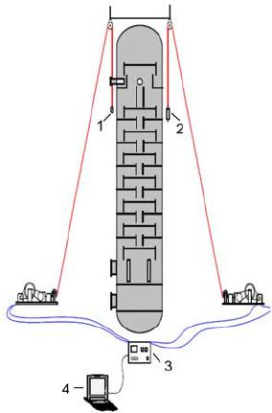
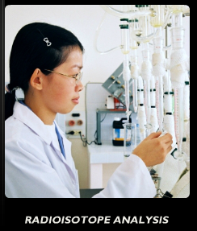
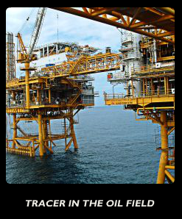
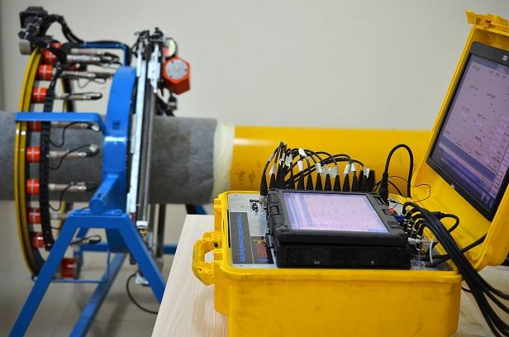
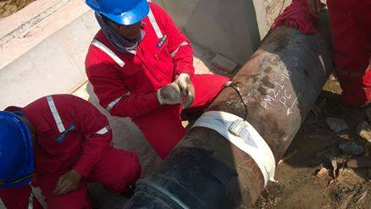
CANTI reseaches and provides NDT services: Gamma scan, LRUT, Computed tomography (CT), Radioisotope analysis,…
CT scan
LRUT
Gamma scanning
www.canti.vn

Slide 4
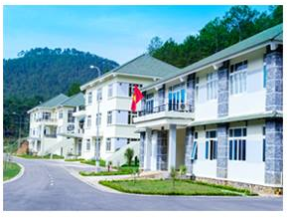
DOSIMETRY LABORATORY OF CANTI
In early 2018, CANTI’s dosimetry laboratory was founded to perform individual dosimetry service.
Human: include 4 people in which 2 master of sciences, 2 researchers.
Facilities and environmental conditions:
www.canti.vn
Notes:
All of them have certificate of dosimetry service which were provided by Vietnam Agency for Radiation and Nuclear Safety (Varans).
Average Temperature: highest: 21 - 25 C degree from Jan to mar, lowest 17 – 19 C degree from octo to decem.
Humidity: lowest: 43 – 68 % from Jan to mar. Highest: 80 - 94% from octo to decem

Slide 5
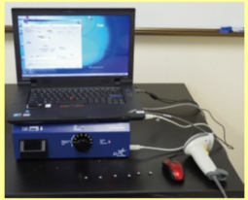
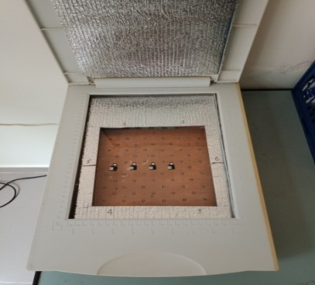
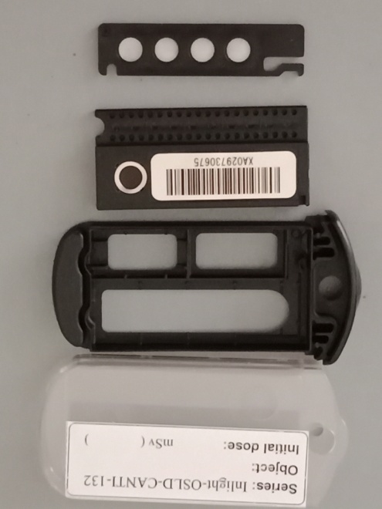
Equipments: microStar reader, annealer, computer, barcode reader, 200 Inlight dosimeter, 15 cabliration dosimeter, nanoDot for research.
www.canti.vn

Slide 6
Metrological traceability:
National standard TCVN 7174: 2002 (ISO 12794: 2000)
Technical materials of Landauer.
RS-G-1.3 Assessment of Occupational Exposure Due to External of Source of Radiation publication by IAEA
www.canti.vn
Notes:
Quality of dosimeters and reader were assessed base on

Slide 7
QA\QC Program:
www.canti.vn

Slide 8
Quality of dosimeters (TCVN 7174: 2002 )
Energy depend
Linearity
Lower Limit of Detection
Reproducibility
Uniformity
Quality of Reader:
Performance: Dark, Cal, Led
Calibration: Low dose, High dose.
www.canti.vn

Slide 9
Number of service
Monitoring individual dosimetry for employee of CANTI
Dosimetry service of CANTI haven't customer yet.
Problems
New subject in CANTI
Lack of experience.
Object
Maintain the dosimetry laboratory
Improve QA\QC program
www.canti.vn

Slide 10
Thanks for your listening
www.canti.vn

