Slide 1
Country Report PNRI-Philippines
Ave Ann Nikolle M. Garalde
Radiation Protection Services
Nuclear Services Division
Philippine Nuclear Research Institute

Slide 2
Outline of Presentation
Organizational Structure
Overview of Function
Facilities
Service Profile
Quality Objective
Accuracy
Timeliness
Customer Satisfaction
Future / Ongoing Activities

Slide 4
Overview of Function
Radiation Protection Services
Personnel dosimetry services
Radiation control services
Calibration services of radiation monitoring devices and medical equipment
Radioactive waste management services
Establishment of national radiation standards

Slide 5
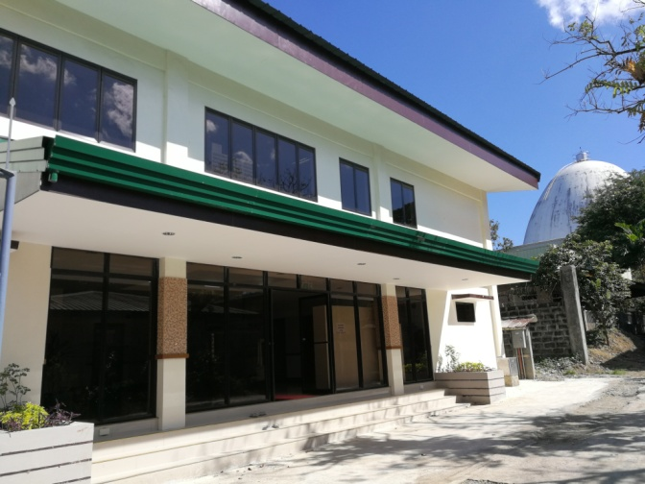
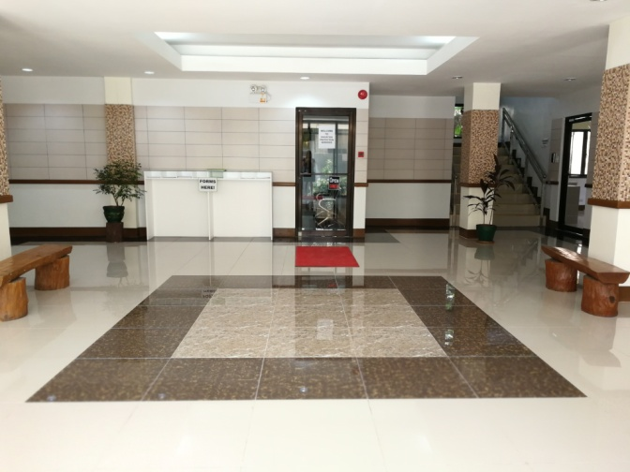
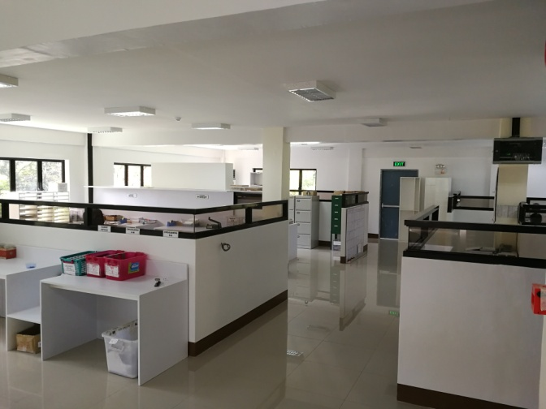
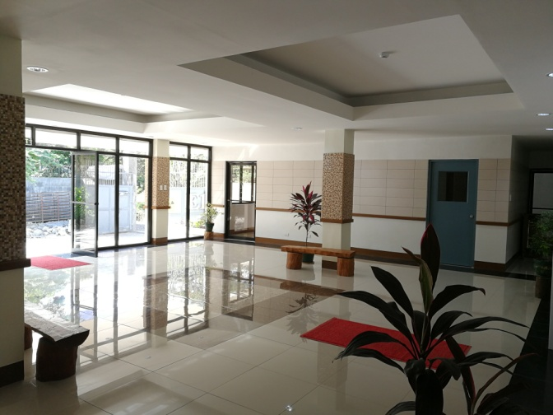
New Two-storey Radiation Protection Services Facility
The new Radiation Protection Facility of RPSS

Slide 6
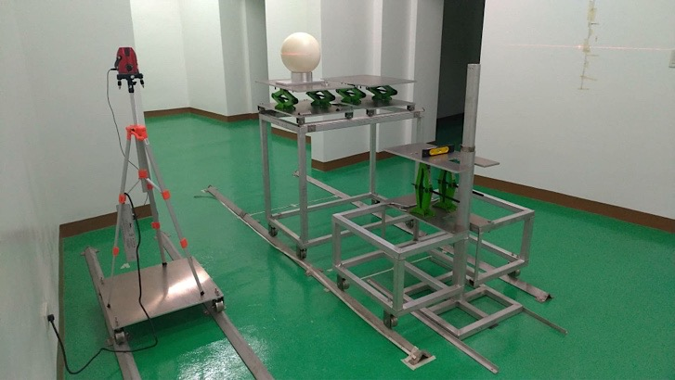
Completion of the Neutron Dosimetry Laboratory
Neutron irradiator room (left) and neutron standard sources in the laboratory (right)

Slide 7
OSL (INITIAL) PROCESSING & ISSUANCE
USE OF OSLs IN THE RADIATION WORKPLACE
APPLICATION
RPS OSL personnel monitoring service
GENERATION OF DOSE REPORT
RETURN AFTER THE MONITORING PERIOD
(FINAL) PROCESSING & EVALUATION

Slide 8
2018 Service Profile
Service Provided | Unit | No. of OSLs | No of Clients | % Increase (from 2017)
OSL Personal Dosimetry Services | DOSIMETERS issued, processed & evaluated | 49,751 (∼4,146 / mo) | 8,482 | 5%
TLD Personal Dosimetry Services |  | 15,756 | 0 | 1,505

Slide 9
OSL Dosimetry Service Over the Years

Slide 10
Quality Objectives of the Service
To provide 85% of the total issuances returned every month with accurate assessment of personal doses of occupationally exposed workers within 40 working days upon receiving.
Accuracy
Annual Calibration
Daily Quality Control / Weekly Constancy Test
Inter – Comparison Program (2018 – JAEA, SEA OSL Group)
Timeliness
Time it took to generate dose reports
Costumer Satisfaction
Costumer Feedback

Slide 11
Future / Ongoing Activities
From manual processing to automatic processing
Transition from ISO/IEC 17025: 2005 to 2017 version of the standard
Neutron personnel monitoring service
Upgrade radiation protection laboratory and SSDL
National dose registry

Slide 12
Maraming Salamat Po!

